Slide 1
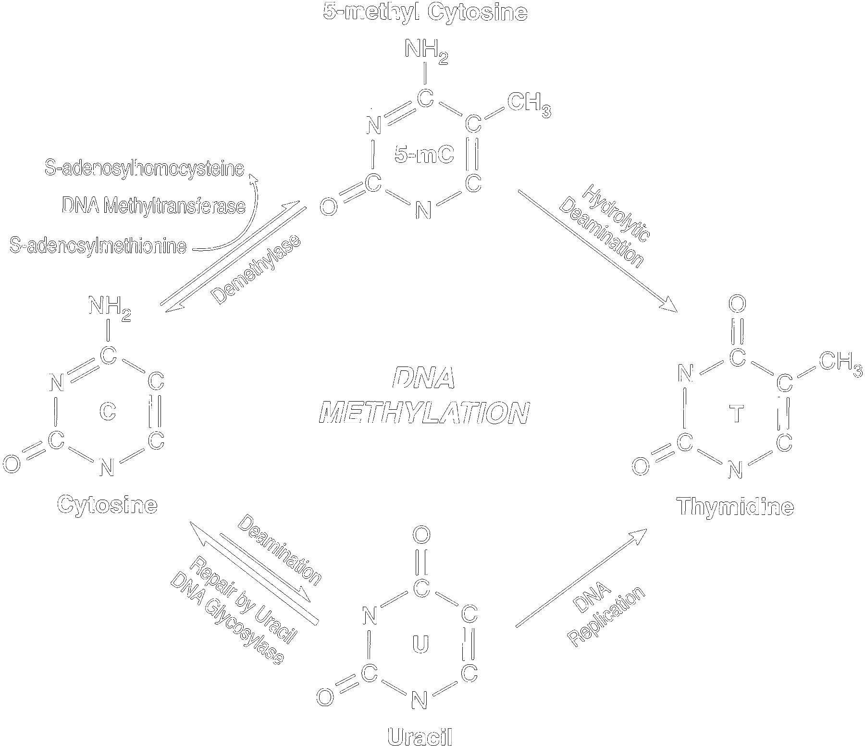
DNA Methylation for the Diagnosis and Characterization of Four Psychiatric Disorders
Author
Christopher Bartlett
Biomedical & Health Informatics
Supervisor
Isabelle Bichindaritz
Biomedical & Health Informatics

Slide 2
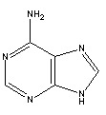
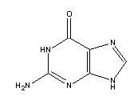
Epigenetics
Epigenetics is the study of genetic alterations that do not affect the sequence of DNA.
Epigenetics is essentially additional information layered on top of the sequence of letters that makes up DNA.
The sequence of letters are strings of molecules called:
A,
C,
G,
and T
If DNA is the text in an instruction manual explaining how to make the human body
Epigenetics is someone taking multiple highlighters and marking up the text in different ways
Adenine
Cytosine
Thymine
Guanine

Slide 3
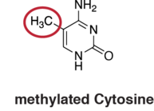
DNA Methylation
Methylation is the addition of a methyl group to cytosine or adenine
Found, almost exclusively, in CpG sites within mammals
Typically associated with suppressing gene expression
Methylation tells the cell: “Don’t worry about this right now”
Associated with aging, development, and cancer onset
Used to investigate epigenetic differences in individuals diagnosed with a psychiatric disorder

Slide 4
Previous Research
Recently, differentially methylated CpG sites were used to differentiate tumor samples from four common cancers (breast, tumor, liver and lung) with that of normal tissue (Hao et al., 2017)
The correct diagnosis rate for their training set was 98.4%
Replicated in the validation cohort for a statistically similar rate of 97.1%.
These findings suggest a potential usage of DNA methylation profiles for the diagnosis of cancers
Plan to investigate its potential for psychiatric disorders

Slide 5
Masters Thesis Proposal (Aims)
Investigate whether four mental disorders can be correctly identified by DNA methylation profiles.
Schizophrenia, Bipolar Disorder, Posttraumatic Stress Disorder, and Major Depressive Disorder
Determine a methylation signature associated with each mental disorder and whether feature selection improves on classification performance.
Construct a list of associated genes for each of the four disorders and investigate the classification effectiveness
Map these associated genes to their associated pathways using pathway analysis software

Slide 6
Data Acquisition and Assembly
Three GEO datasets were selected from ArrayExpress
All of the datasets used the Illumina HM450 BeadChip (tests ~453,000 sites)
Age, Gender and Disorder types were extracted and constructed a Phenotype dataset
Normalized methylation beta values were compiled for each disorder, with a psychiatrically normal control set
Beta values are an estimated methylation level between 0 and 1
Disorder | Number of Samples
Schizophrenia | 62
Major Depressive Disorder | 34
Bipolar Disorder | 24
Post-Traumatic Stress Disorder | 29
Control | 264

Slide 7
Global Analyses
Hypermethylation was defined as a beta value greater than 0.8
Hypomethylation was defined as a beta value less than 0.2
Moderate methylation was defined as 0.5 and above
Computed the percentage of probes meeting the criteria
Disorder | Hyper | Hypo | Moderate
Schizophrenia | 37.4% | 38.2% | 53.1%
Major Depressive Disorder | 43.6% | 35.1% | 55.6%
Bipolar Disorder | 39.9% | 36.2% | 54.3%
Post-Traumatic Stress Disorder | 46.0% | 37.4% | 55.3%
Control | 45.1% | 37.7% | 55.0%

Slide 8
Differentially Methylated Regions (DMR)
DMR analysis clusters probes together depending on their biological proximity
Conducted with a 0.05 P-value cutoff, and minimum probe number of 20

Slide 9
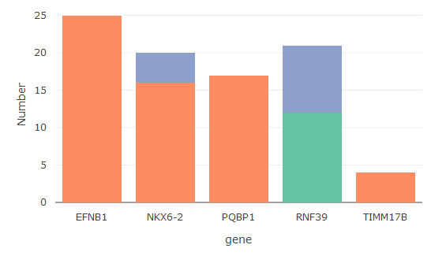
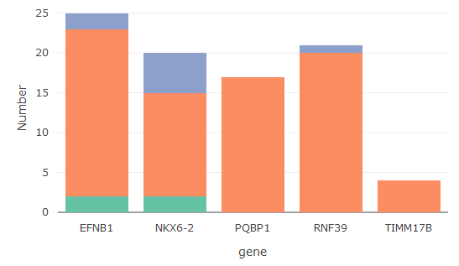
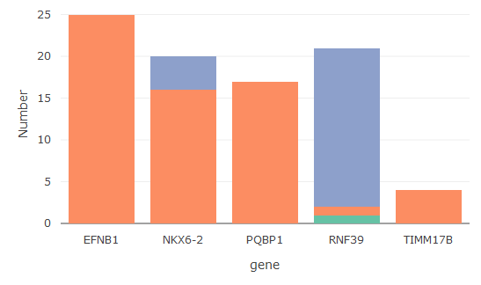
Hyper
Bipolar Disorder
Hypo
Not significant
Schizophrenia
Major-Depressive Disorder

Slide 10
Gene | Suspected Role
EFNB1 | Cell adhesion and function in the development or maintenance of the nervous system
NKX6-2 | Protein Coding gene
PQBP1 | mRNA splicing, and transcription regulation
RNF39 | Early synaptic plasticity
TIMM17B | Transport of mitochondrial proteins

Slide 11
Future Directions
PTSD was temporarily excluded from analyses
Significant differences in age between PTSD subgroup and control group
No significant probes or regions detected
Determine classification accuracy without feature selection
Determine classification accuracy with feature selection
Differentially methylated positions
Differentially methylated regions
Associated genes
Associated pathways
Determine which stage produces the highest diagnostic accuracy

