Slide 1
UX Presentation
Ahmadjan Ataniyazov
Eian Prinsen
Joseph Gray
Heather Rohr
Tina Gada

Slide 2
Introduction
Society has seen a general increase in reported mental health issues. People are now more than ever aware of their own mental health, and are given the opportunities to get help.
Technology is a useful self help tool for users to help improve their mental health.
Our aim was to create an application that allows our users to test anxiety levels along with other mental health issues, and provide them with support options.

Slide 3
Executive Summary
Problem statement:
CY Technologies Inc. came to us with the following problem
“Create an app that allows individuals to screen for symptoms of four common mental health issues: depression, anxiety, post-traumatic stress, and alcohol problems. Users complete validated measurement instruments Based on users’ scores, the app provides two recommendations:- Direct users to brief mindfulness-based breathing exercises - Connect users to mental health providers near them The app should also enable users to monitor their progress over time - They can complete the self-assessments multiple times - Users should be able to access and share their progress report.”

Slide 4
TL;DR
Create an app that measures common mental health issues and supports the user by tracking progress, maintaining their health and finding the proper support.

Slide 5
Executive Summary Cont.
We experienced a few challenges when developing this product,
First, the subject matter of mental health makes testing the product somewhat difficult.
Second, working collaboratively to find solutions proved a to be a challenge.

Slide 6
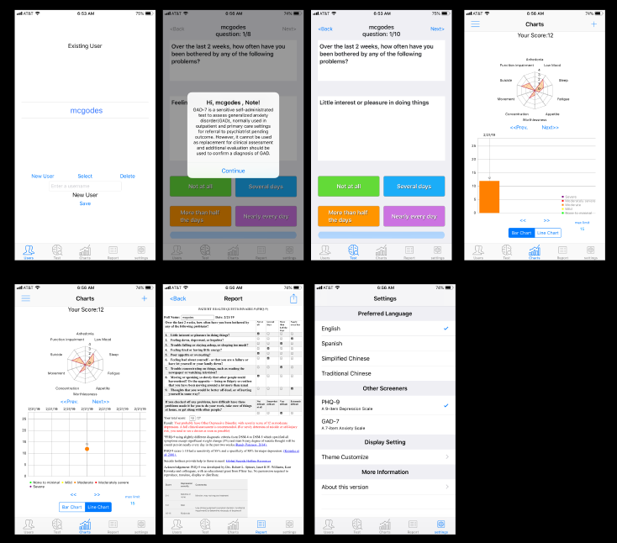
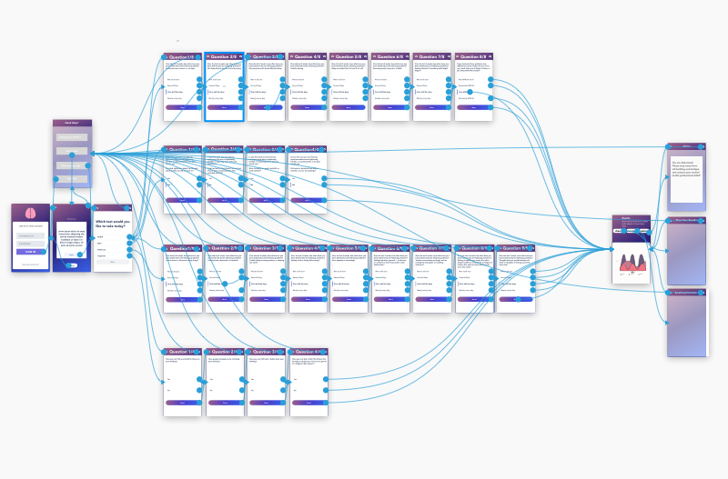
New Product

Slide 7
Hi-Fidelity Prototype
Link to hi-fi prototype:
https://xd.adobe.com/view/6f7a870f-8d11-4d16-7265-04fb61733c66-194b/

Slide 8
Evaluation Methodology
Our aim of this usability test was to test the measure of efficiency, effectiveness, and satisfaction of the product based on industry standards of UX metrics.
The prototype testing was broken down to five main tasks with subtasks:
Log in
Complete survey
View and share results
Complete breathing exercise
Find a specialist
The results were measured using task completion time, self-reported satisfaction rate, and task completion rate.

Slide 9
Results
All participants successfully completed Task 1 - logging in to the app and Task 2 - completing the survey.
The completion rate for Task 3 - viewing the results is 70%, some are partially completed.
Two couldn’t complete Task 4 - breathing exercise, the completion rate is 50%.
80% were able to complete Task 5 - finding a specialist.

Slide 10
Results
Task 2 required participants to complete the mental-health survey and took the lower time to complete (mean = 65 seconds) than our target (90 seconds).
However, completion times ranged from 1 to 9 seconds (mean = 3.4 seconds) on Task 1 which is less than our target time (10 seconds).

Slide 11
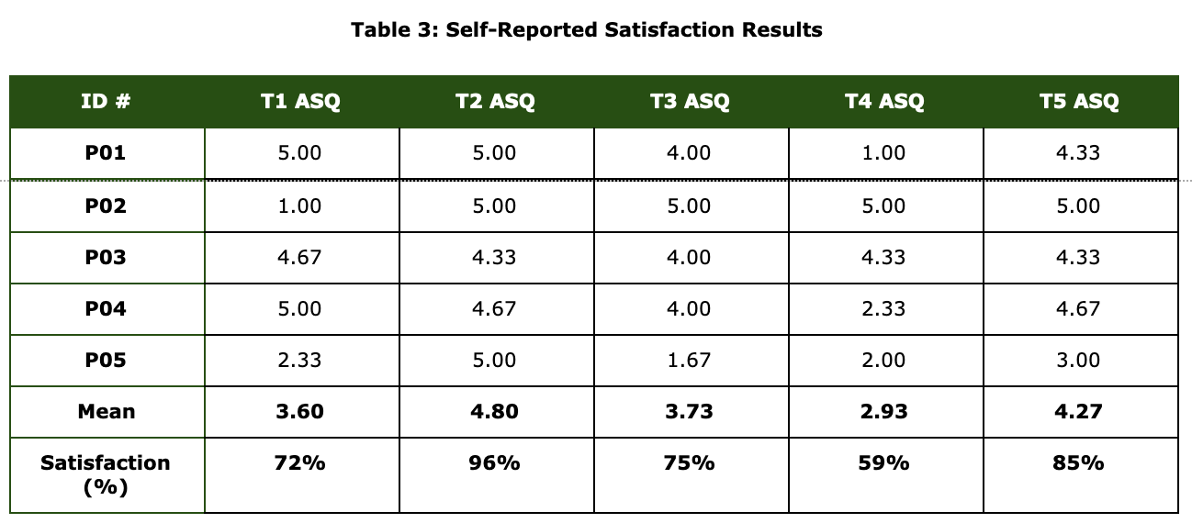
Results
Most of the participants (72%) satisfied that Task 1 (Logging In) was easy to use.
The majority of the participants (96%) satisfied with Task 2 (Taking Survey).
There were 75% satisfaction rate for viewing results task.
Approximately half of our participants (59%) satisfied having experience with breathing exercise task.
85% of satisfaction rate occurred in finding a specialist task.

Slide 12
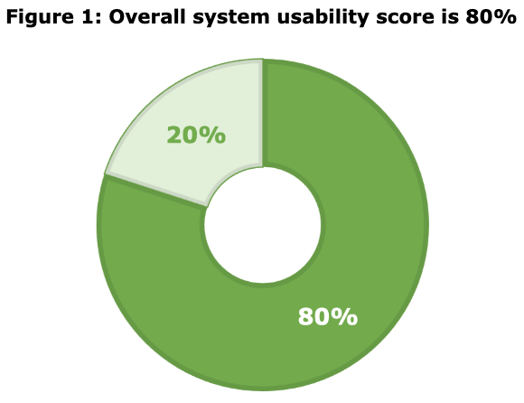
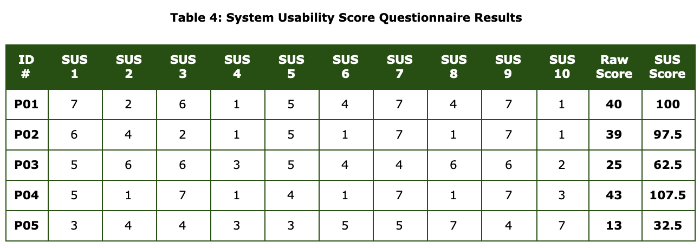
Results

Slide 13
Discussion
From our study, two common issues for our users stood out:
The results section wasn’t clearly defined
The “Breathing Exercises” did not work properly for most users
While the number of issues present was low, the issues noticed are key features of the application and will be adjusted to improve the user experience.

Slide 14
Future Development
Clear and concise affordances on each page
Improve “Breathing Exercise” experience
Improve understanding of results and graphs
Deeper connections with professional support

Slide 15
Conclusion
Personal topics dealing with mental health is a sensitive subject for most.
In order to create a enjoyable user experience it’s crucial that we create an interface that is both comfortable to use and stress free.
As we continue to develop we need to create a relationship between developers and mental health experts to create a consistent experience for users.
We strive to create an experience that doesn’t simple translate results, but serves as a support group for our users.
Notes:
To continue to develop with caution for a sensitive subject--- Mental health applications require good precision
Emotional and personal topics are often more vulnerable to frustration meaning each decision made is crucial for a good user experience; Some designed were inspired by pre-existing methods and UX; The application to served more as a translator rather than a support group.
A stronger relationship between the developers and the psychologists that they pull from will help to create a stronger bond between the application and the user

