Slide 1
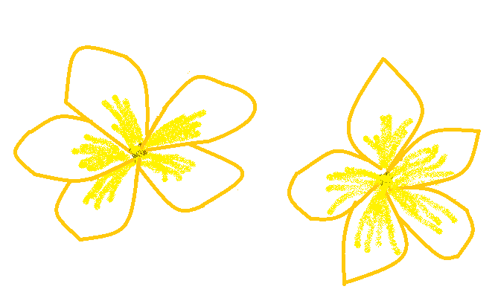
Plumeria Café
Internet Café Database Project
Group Member: Heather Rohr

Slide 2
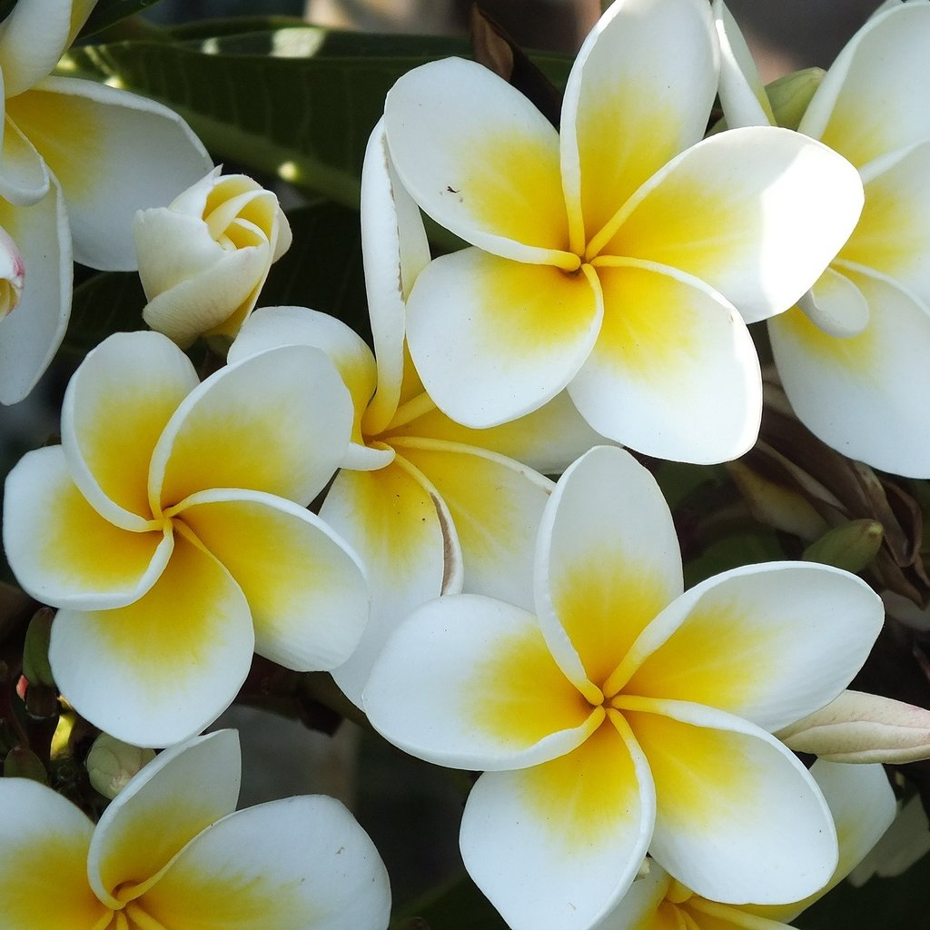
Plumeria Flower
Found in warm regions of Polynesia, Mexico, Central, the Caribbean, and parts of South Brazil

Slide 3
The Basic Idea for the Database
Internet Café open for local visitors, travelers, migrant workers, and service people.
The database in access itself would the have hardware inventories, and information in regards to the people using them.

Slide 5
What is in the database (and café)?
Customer Information
Computer Information for hardware used by customers
Employee information
Computer Information for hardware used by Employees
Routers
Computer Log in list (for customers)

Slide 6
Computer_Log

Slide 7
Computer_Log . Brief List of Tuples

Slide 8
Customers

Slide 9
Customers , Brief List of Tuples

Slide 10
Café_Computers (partial)

Slide 11
Café_Computers . Brief list of Tuples (with all Attributes)

Slide 12
Internet_Routers

Slide 13
Internet_Routers

Slide 14
Employees

Slide 15
Work_Computers (partial)

Slide 16
Employees and Work_Computers . Brief List of Tuples with Attributes

Slide 17
Normalization (for Computer_Log)

Slide 18
Normalization (for Employees)

Slide 19
Basic SQL

Slide 21
Relationships in Access

Slide 23
Questions or comments?

Slide 24
THANK YOU

