Slide 1
ilovecoffee.jp
Heather Rohr’s project
(About a coffee website by Ryoko Iwata)

Slide 2
http://en.ilovecoffee.jp/ - English Version

Slide 5
http://ilovecoffee.jp/ - Japanese Version

Slide 6
Web address and domain origin
ilovecoffee.jp
Japanese Version of website
En.ilovecoffee.jp
English Version of website
Domain typical on other websites
.com
.org
.edu
.mil
.gov

Slide 7
Web address and domain origin
ilovecoffee.jp
Japanese Version of website
En.ilovecoffee.jp
English Version of website
Domain typical on other websites
.com
.org
.edu
.mil
.gov

Slide 8
Web address and domain origin
ilovecoffee.jp
Japanese Version of website
En.ilovecoffee.jp
English Version of website
Domain typical on other websites
.com
.org
.edu
.mil
.gov

Slide 10
Page Source- Main index

Slide 11
Java script for Main Page

Slide 12
Cascading for Main Page

Slide 13
Cascading for Main Page

Slide 14
W3schools.com - colors

Slide 15
W3schools.com - colors

Slide 17
Page Source- Main index

Slide 18
Mobile Version

Slide 19
Not all websites convert well to a mobile version; Ryoko’s colleague, Matt Inman, criticizes this.

Slide 20
Mobile Version

Slide 21
Ryoko’s I Love Animals website

Slide 22
Ryoko’s I Love Sauna website (Only in Japanese at the moment)

Slide 23
There are different article and infographic to click on…

Slide 24
Coffee Around the World “Article”

Slide 25
Page Source

Slide 26
Page Source

Slide 27
Page Source

Slide 28
Entire Image; only part of it is visible to read on the webpage at a time.

Slide 33
I love coffee – random post Bottom of the page after reading…

Slide 34
The Oatmeal – Main Page for website made by Matt Inman A friend of Ryoko who also lives in the Seattle area https://theoatmeal.com/

Slide 35
Random links to click on found after a user reads one of The Oatmeal’s comics

Slide 36
Ryoko and “The Oatmeal” each wrote a page about things may have not known about cats

Slide 37
You can also visit the “SHOP”

Slide 38
https://shop.spreadshirt.com/ilovecoffee/ I LOVE COFFEE SHOP - Printing, shipping and service by Spreadshirt

Slide 39
https://www.spreadshirt.com/

Slide 40
https://www.spreadshirt.com/

Slide 41
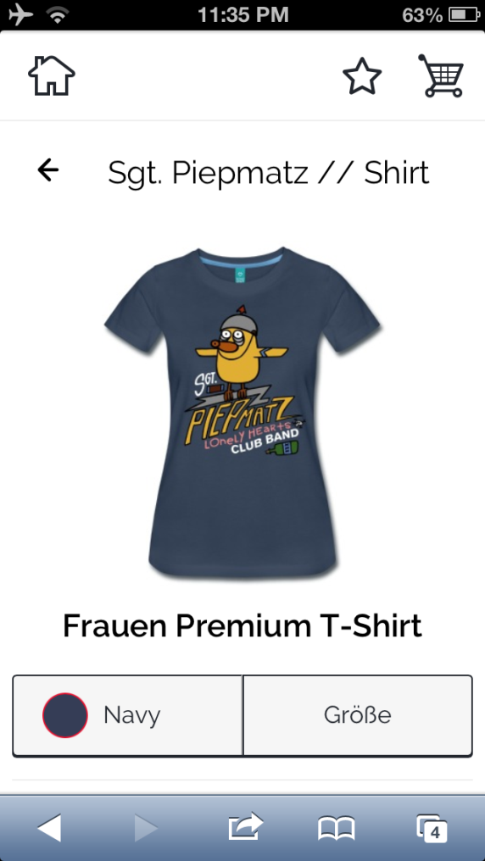
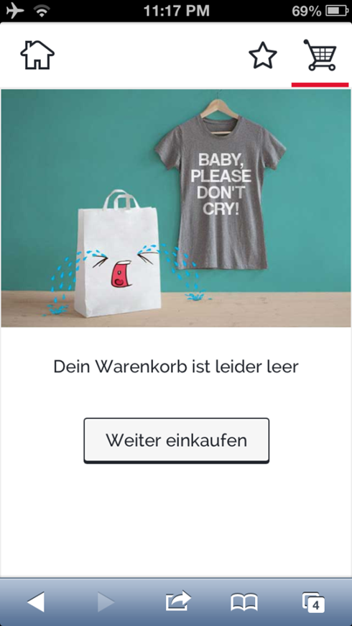
the inner world – shirts based off a point & click game also uses Spreadshirt https://shop.spreadshirt.de/theinnerworld/ (only in German)
* Great. I'm stuck in the crazy forest .

Slide 42
Without leaving the page, there is just a plain message to inform user that the cart is empty.

Slide 43
Top of I Love Coffee page

Slide 44
Footer of I Love Coffee page

Slide 45
Facebook

Slide 47
Twitter

Slide 49
Pinterest

Slide 51
Google + (plus)

Slide 53
Instagram

Slide 55
RSS …

Slide 56
RSS https://en.wikipedia.org/wiki/RSS

Slide 57
RSS https://en.wikipedia.org/wiki/RSS

Slide 58
The bear in the coffee… it is a link, too.

Slide 59
Another way to visit I Love Animals

Slide 60
Near the Language Option, is a link to Sushi web links

Slide 61
I Love Sushi

Slide 62
Ryoko Iwata released a book in 2015

Slide 63
Ryoko Iwata released a book in 2015

Slide 64
(This image was more visible on Chrome than Internet Explorer for some reason)

Slide 65
ISC 496 - Heather Rohr - 2018

