Slide 1
GlucoTech
Project
BHI 504 ORAL PRESENTATION
Team Members: Desai, Gaitos, Adebiyi, Tota

Slide 2
Contents
Brief overview of the project Information on Diabetes Mellitus User Types and Roles User Stories and Artifacts Business Rules Nonfunctional Requirements | Class Diagram Collaboration Diagram Sequence Diagram Paper Prototypes Code and Test Future Work and Final Thoughts References

Slide 3
Project Overview

Slide 4
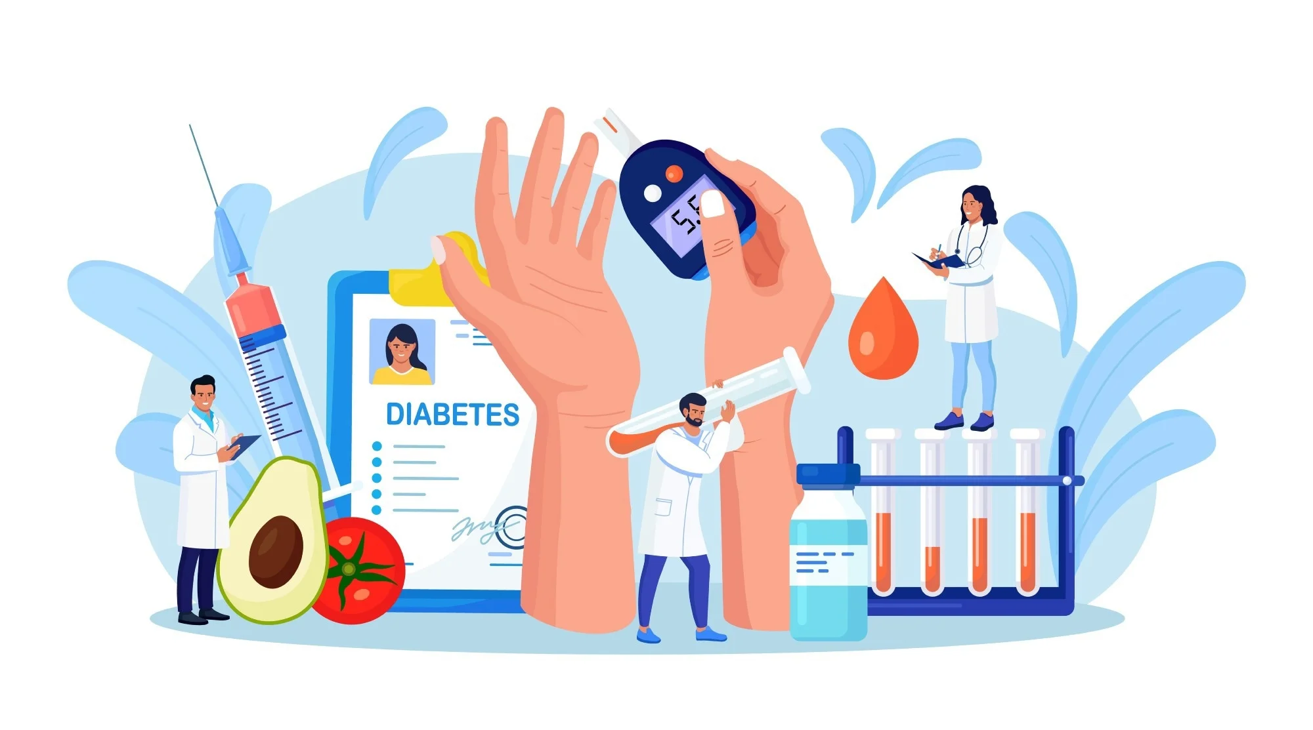
Project Overview
Designed for individuals/patients with diabetes/diabetes mellitus(DM).
The GLUCOTECH project aims to collect and store data in the cloud, providing real-time accurate blood glucose levels and system alerts to patients, caretakers, and healthcare professionals to manage diabetes mellitus and prevent its complications effectively. Hence the project will provide more focused patient-centered care and better and interactive data visualization.
This project will also incorporate an alert prompt system about abnormal levels of blood glucose that will help and inform both individuals diagnosed with DM and health professionals when to take necessary actions.
This project will help individuals diagnosed with DM to maintain their blood glucose levels without any inconvenience of forgetting when to take or not take their medications, and also help health professionals when adjusting the next treatment plan.
Most importantly, this project will limit cases of complications from uncontrolled Type 1&2 DM, with the help of biomedical and health informatics, through knowledge gained in this course.

Slide 5
Information on Diabetes Mellitus

Slide 6
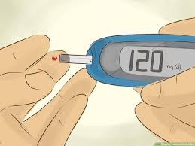
Diabetes Mellitus
Diabetes Mellitus is the scientific name for Diabetes, and it is characterized by the impaired ability of the body to produce or respond to insulin leading to elevated blood glucose levels.
There are two types of DM:
Type 1(Known as Juvenile diabetes or insulin-dependent diabetes. Here the body, specifically the pancreas, produces little to no insulin).
Type 2(The most common. It is usually seen in adults and occurs when when the body fails to respond to insulin or fails to produce enough insulin leading to metabolic syndrome).
DM is not the same as Diabetes insipidus(DI). DI is a rare condition where your body produces too much urine and isn't able to properly retain water.

Slide 7
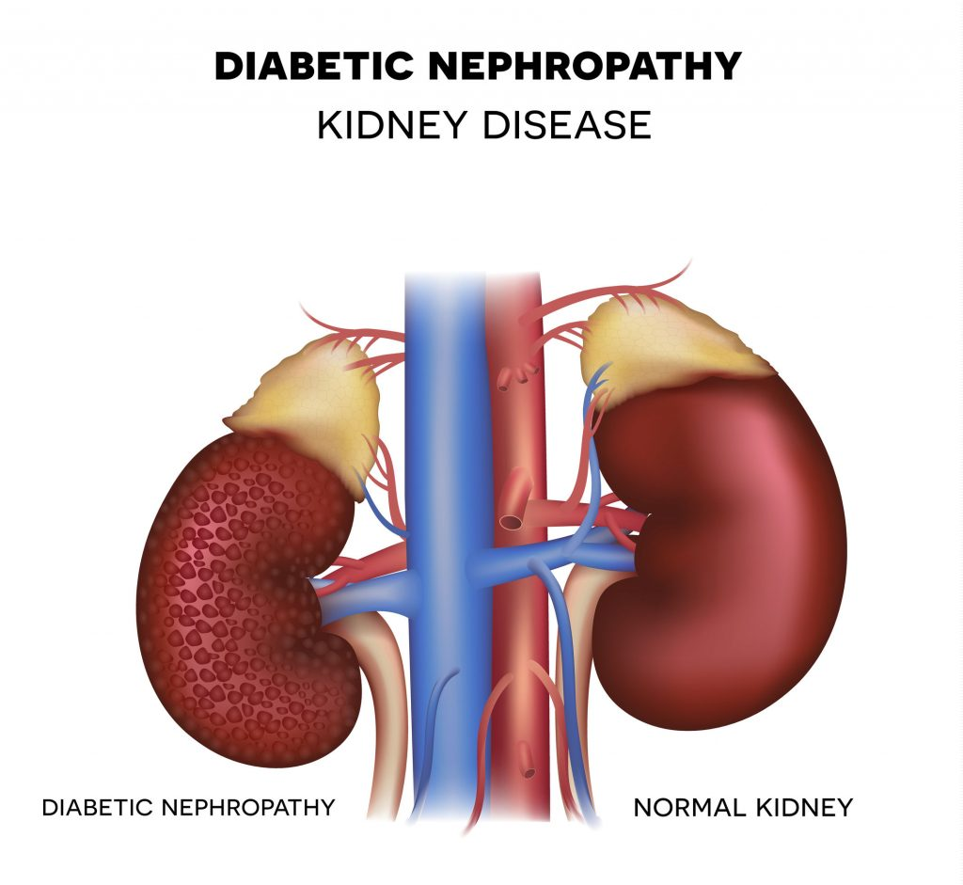
Why is this important?
Currently, 422 million people worldwide are diagnosed with DM, including individuals from low- and middle-income countries. Around 1.5 million deaths are attributed to DM every year. The number of cases is still rising rapidly.
Uncontrolled blood glucose levels can lead to debilitating complications, such as atherosclerotic cardiovascular disease, heart failure, stroke, chronic kidney disease, diabetic retinopathy, neuropathy, foot ulcers, and others, and even death.
According to the World Health Organization (WHO), DM is a major cause of blindness, kidney failure, heart attacks, stroke, and lower limb amputation. Furthermore, adults with DM have a two- to three-fold increased risk of heart attacks and stroke.

Slide 8
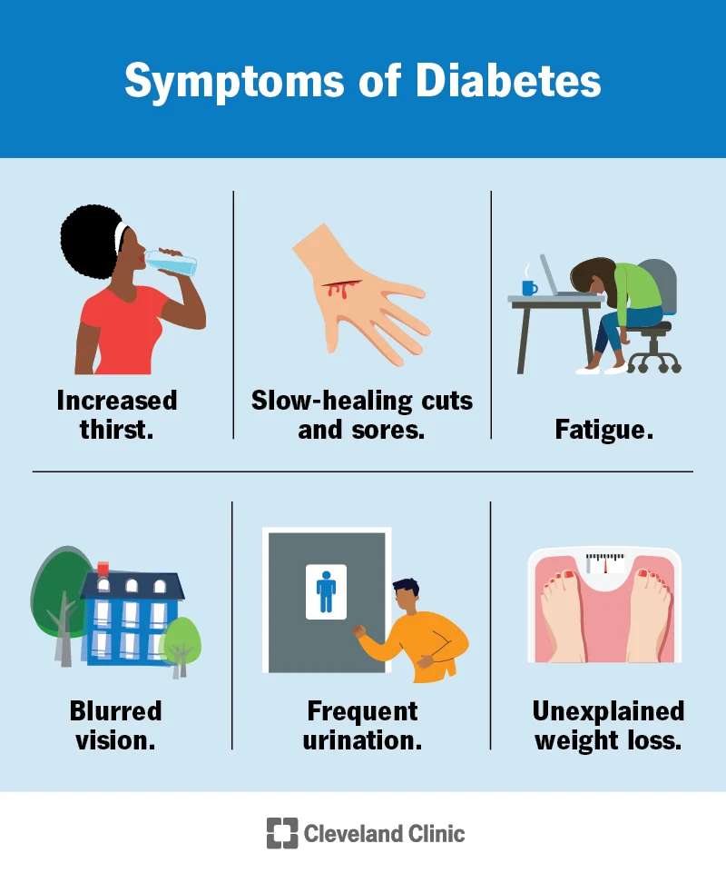
Diabetes Symptoms
Increased thirst(Polydipsia)
Increased hunger(Polyphagia)
Increase urination(Polyuria)
Fatigue
Blurred vision
Slow-healing sores or cuts
Fatigue
Numbness or tingling in your hands or feet.
Unexplained weight loss

Slide 9
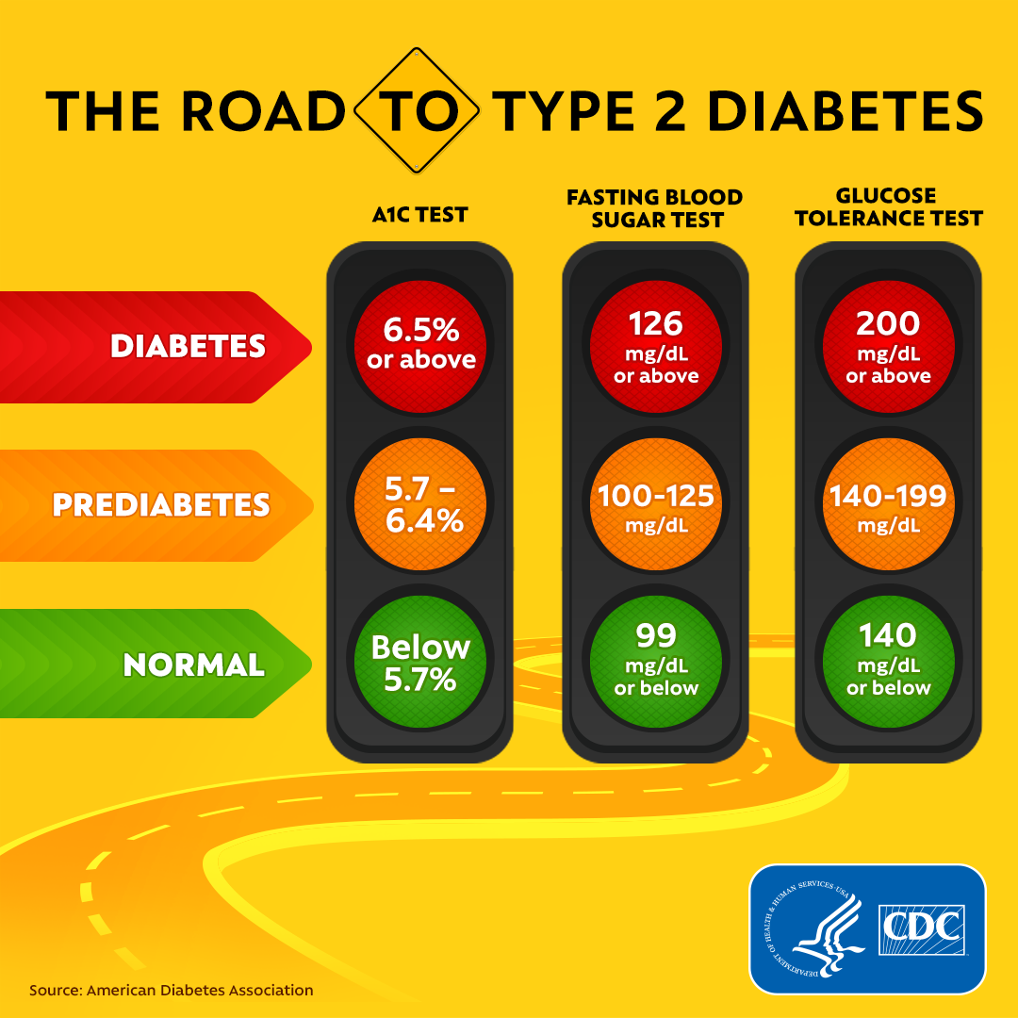
Diabetes Blood Test
The HbA1C test measures your average blood sugar level over the past 2 or 3 months.
The FBST measures your blood sugar after an overnight fast (not eating).
The GTT measures your blood sugar before and after you drink a liquid that contains glucose. You’ll fast (not eat) overnight before the test and have your blood drawn to determine your fasting blood sugar level.
Then the blood sugar level checked 1 hour, 2 hours, and possibly 3 hours afterward.

Slide 10
User Types and Roles

Slide 11
User Types and Roles
User Type | Role | Role Description
Patient | Individuals diagnosed with diabetes mellitus | Patients with diabetes mellitus are considered the main consumers who are expected to gain the most beneficial factors from this system. Their only task is to properly perform the fingerstick test. The system will automatically record the blood glucose levels and will prompt a message about whether the blood glucose levels are high or low. The recorded blood glucose level will be sent directly to their electronic medical records.
Clinician | Physicians, Research-Physicians, Nurses, Dieticians | Health professionals providing primary patient care (i.e., physicians, nurses, and physician assistants) will be reviewing the data obtained from the system periodically. They will be provided with a detailed and informative data visualization showing the peaks and troughs of the patient’s blood glucose levels to help them decide on the treatment plan update.
Permitted Relative/Family Member | Relative/Family members | Individuals who are related to the patient will assist the patients in using the glucometer and will also have an access to the website for the viewing of records and alert system functions.

Slide 12
User Stories and Artifacts

Slide 13
User Stories and Artifacts
User Story | User | Object
#1 As a diabetic patient, I want to be able to monitor my blood glucose levels accurately so that I can effectively and actively monitor my condition to prevent its complications, which leads to having a sense of control and engagement in my own health. | Patient | GlucoseLevelMeasurement Diagnosis Complication
#2 As a diabetic patient, I want to be able to receive real-time feedback and alerts based on my blood glucose monitoring so that I can effectively utilize my anti-diabetic medications. | Patient | AlertSystem GlucoseLevelMeasurement
#3 As a diabetic patient, I want to be able to store my blood glucose monitoring securely in the cloud storage of GlucoTech and to be able to access them easily through their website so that I will limit having errors writing them manually and not have a hard time remembering them. | Patient | GlucoseLevelMeasurement GlucoTechWebsite

Slide 14
User Story | User | Object
#4 As a diabetic patient, I want to be able to share my blood glucose monitoring with my clinicians and permitted relatives/family members so that whenever I encounter symptoms (e.g., fatigue, weakness, unconsciousness) from extremely high or low blood glucose levels, they will be able to act accordingly (e.g., provide medication if extremely high blood glucose level or provide suage if extremely low) | Patient | Clinician PermittedRelative/FamilyMember GlucoTechWebsite
#5 As a permitted relative/family member, I want to be able to access and receive blood glucose monitoring with alerts and notifications of my debilitated family members suffering from diabetes so that I can provide them with proper care (e.g., intake of medication, diet, etc.). | Permitted relative/Family member | AlertSystem GlucoTechWebsite Patient
#6 As a physician, I want to be able to track and monitor my patient’s blood glucose levels and to receive real-time alerts and notifications about their abnormal blood glucose levels remotely so that I can adjust and personalize the treatment and provide insights and recommendations (e.g., tests and referrals). | Physician | GlucoTechWebsite Patient AlertSystem Recommendation

Slide 15
User Story | User | Object
#7 As a physician-researcher, I want to be able to use the anonymized data information with consent about blood glucose monitoring so that I can understand and provide innovative works regarding diabetes. | Physician-Researcher | GlucoTechWebsite
#8 As a nurse, I want to be able to access my patient’s blood glucose monitoring so that I can help them be reminded of the proper fingerstick method, the intake of their medications, and their diet. | Nurse | GlucoTechWebsite Patient Recommendation
#9 As a dietician, I want to be able to access my patient’s blood glucose monitoring so that I can provide an individualized dietary recommendation and be able to collaborate with other clinicians regarding dietary needs. | Dietician | GlucoTechWebsite Patient Physician

Slide 16
Business Rules

Slide 17
Business Rules
BR 1. The clinicians with access to the patient’s stored blood glucose level monitoring in the website and the cloud storage are physicians, researchers, nurses, and dieticians. BR 2. The non-clinicians who have access to the patient’s stored blood glucose level monitoring in the website and the cloud storage are the patient and permitted relatives/family members. BR 3. Individuals with access to the patient’s data information have been provided with education on how to navigate the application and cloud through specific usernames and passwords. | BR 4. Physicians alone can modify the patient's treatment regimen, recommend new diagnostic tests, and advise/refer consultations with other specialists to prevent common diabetes mellitus complications. BR 5. Physicians and dieticians alone can recommend individualized diets to patients. BR 6. Nurses report to the physician and refer the patients with abnormal blood glucose level monitoring. BR 7. The system must comply with all relevant data privacy and security regulations and must maintain high standards of data protection. BR 8. The GlucoTech must provide customer support to address any technical issues or concerns raised by users.

Slide 18
Business Rules
BR 9. An individual is considered diabetic if [please refer to the table below (Mayo Clinic, 2023)]: | BR 10. The GlucoTech will provide alert messages to the individuals in BR 1 and BR 2 sections when the patient’s blood glucose level is more than 100 mg/dL or less than 50 mg/dL.
Test | Result
HbA1C | Diabetes - more than 6.5% Prediabetes - 5.7% - 6.4% Normal - less than 5.7%
Random blood sugar | Diabetes - more than 200 mg/dL Prediabetes - *** Normal - less than 200 mg/dL
Fasting blood sugar | Diabetes - more than 126 mg/dL Prediabetes - 100 mg/dL - 125 mg/dL Normal - less than 100 mg/dL
Glucose tolerance | Diabetes - more than 200 mg/dL Prediabetes - 140 mg/dL - 199 mg/dL Normal - less than 140 mg/dL

Slide 19
Nonfunctional Requirements

Slide 20
Nonfunctional Requirements
1. Safety and Security – The system will strictly adhere to HIPAA-provided protocols and encrypt the protected health information to ensure each patient's sensitive information's security, safety, and privacy. Individuals with access to the system are assigned their respective usernames and passwords.
2. Portability – The blood glucose level will be measured and stored automatically in the built-in memory of the blood glucose monitoring device. The blood glucose level monitoring will be uploaded via an internet connection into the GlucoTech cloud and website compatible with iOS, Android, and Windows. The blood glucose level monitoring can be accessed through the application and the GlucoTech cloud.
3. Interoperability and Integration – This requirement ensures that the blood glucose level monitoring obtained from the glucometer device will be sent and stored efficiently in the GlucoTech cloud for easy and real-time accessibility and data exchange through the GlucoTech website. Data obtained from the glucometer device will be subjected to an integration tool to ensure the system achieves interoperability.
4. Usability – The stored data information can easily be accessed and navigated by individuals with basic smartphone usage knowledge and correct usernames/passwords. The alert system will automatically prompt to logged-in individuals whenever the system reads abnormal blood glucose levels. The data information can be displayed in two different views, a list or a graph, for easy understanding.
5. Reliability – The data information transmission is smooth and quick among the glucometer, the smartphone application, and the GlucoTech cloud, given that there are a good internet connection and good physical states (including battery charge) of each device (glucometer and smartphone).
6. The patients, clinicians, and permitted relatives will be instructed on how to navigate the application. They will be taught how to use the application, access the blood glucose level monitoring, and receive alert systems.

Slide 21
Class Diagram

Slide 22
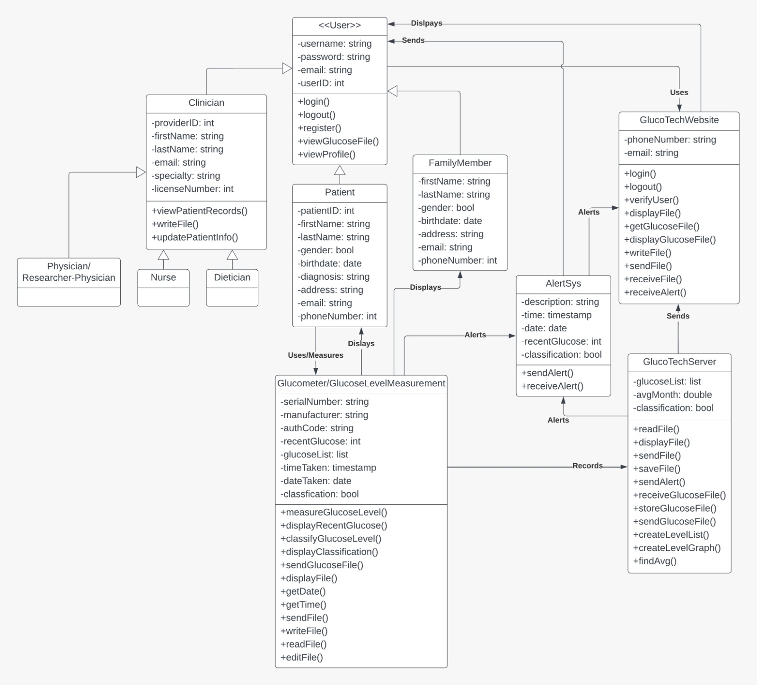

Slide 23
Collaboration Diagram

Slide 24
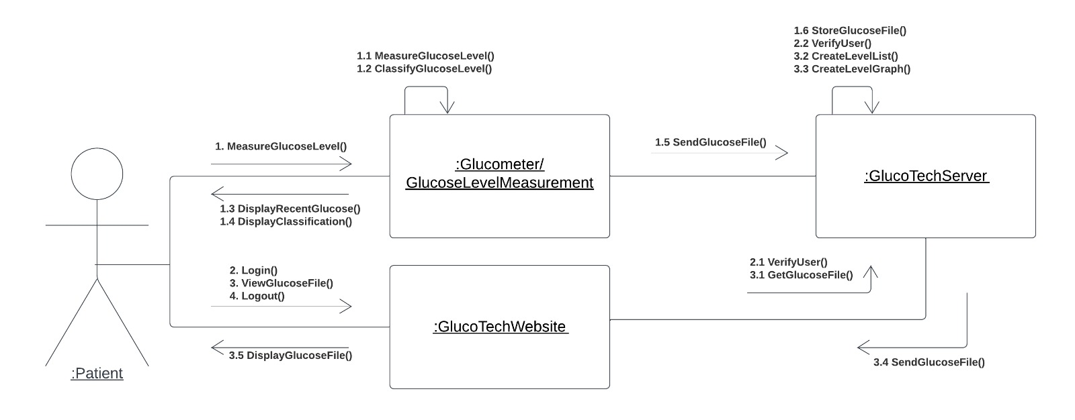
This collaboration diagram illustrates the project's close-loop workflow. The patient measures his blood glucose levels and submits them on the GlucoTech Website, which sends the information to the company's server, which stores it. The server will deliver the files to the website so that viewers can view them whenever someone requests to see a particular patient file. Users must log in using their credentials in order to use the website.

Slide 25
Sequence Diagrams

Slide 26
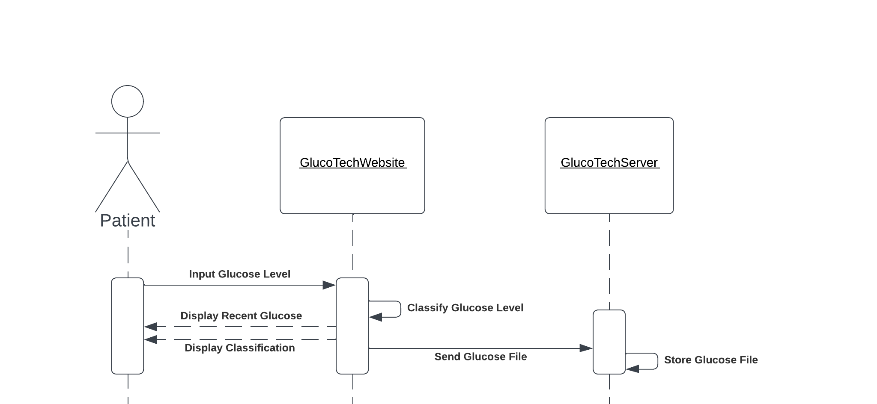
Sequence Diagrams #1 (User Story #3)
I want to be able to safely store my blood glucose monitoring data in GlucoTech's cloud storage and have easy access to it through their website as a diabetic patient so that I can avoid making mistakes while manually storing it and don't struggle to remember it.

Slide 27
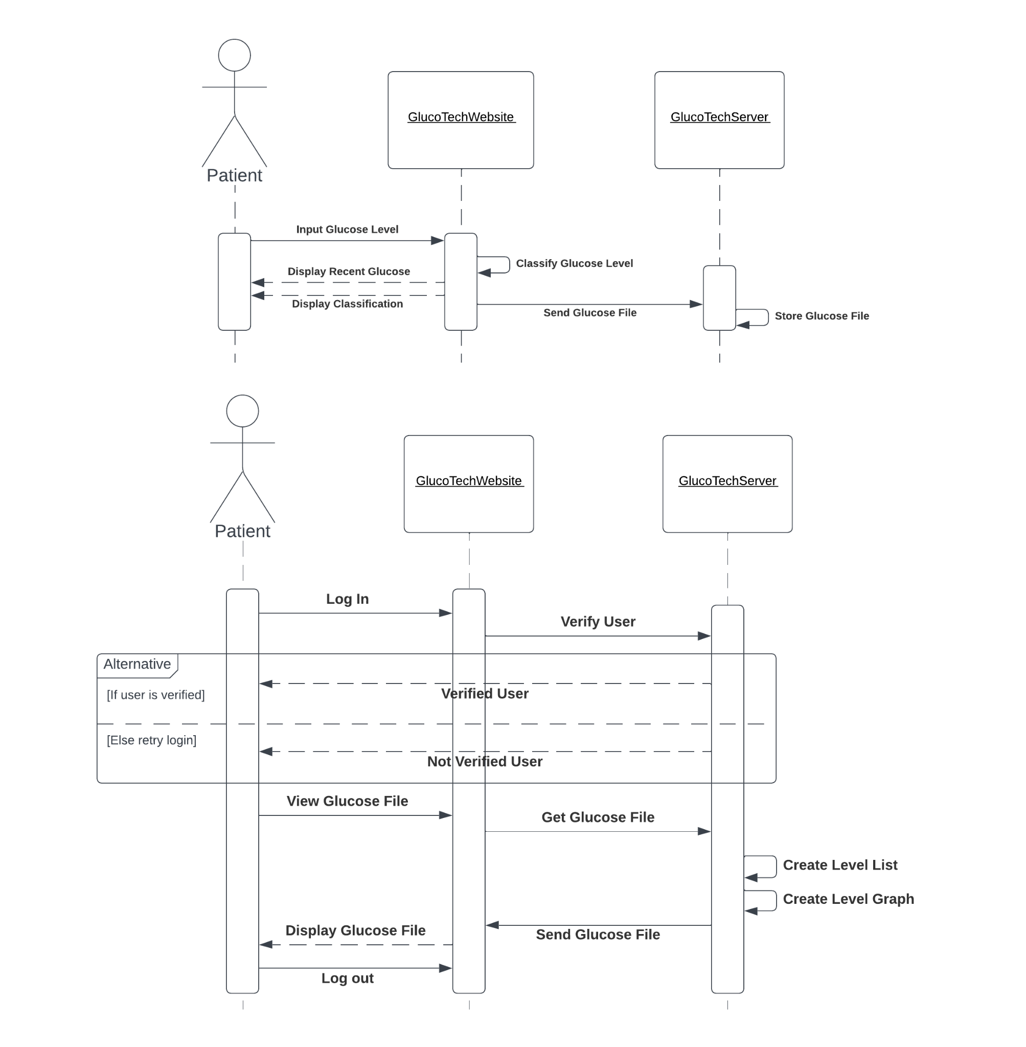
Sequence Diagrams #2 (User Story #3)
This flow chart demonstrates how a patient uses a glucometer, how the device classifies blood glucose readings, and how it delivers those readings to the GlucoTech Server/Cloud. The device will then show the blood glucose monitoring data that was recorded. The GlucoTech website provides access to blood glucose levels for patients who want to keep tabs on them. The GlucoTech Server/Cloud will confirm their identity after they log in using their credentials. Once verified, they can access the list and graph formats of the server-generated blood level monitoring. They can log out of their accounts after accessing their data.

Slide 28
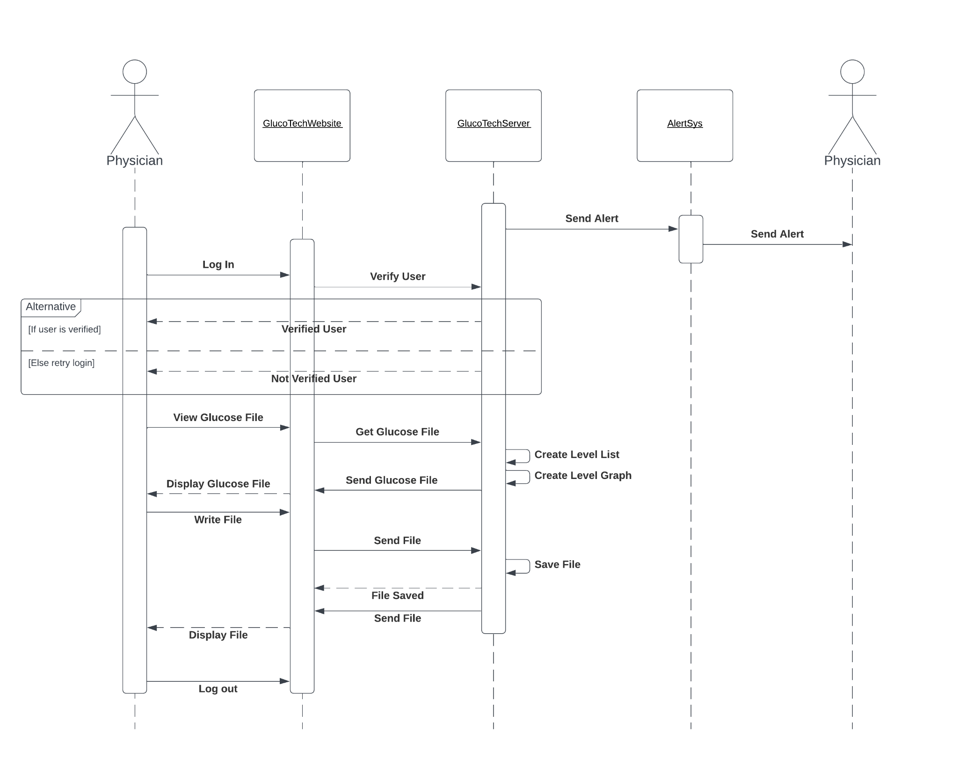
Sequence Diagram #3 (User Story #6)
This sequence diagram illustrates how a physician receives an alert message from the GlucoTech Server/Cloud when it receives an abnormal blood glucose level from the blood glucose level measurements. The Alert System will automatically send a notification message that can be accessed through GlucoTech Website or text message. The physician can log in using their credentials via the GlucoTech Website. Their credentials will be verified from the GlucoTech Server/Cloud. Once verified, the physician can access the server-generated list and graph and write a recommendation for their patients. The recommendation will be uploaded and stored in the GlucoTech Server/Cloud. The new recommendation will be displayed once it is saved. After updating their patients’ files, the physician can log out of their account.

Slide 29
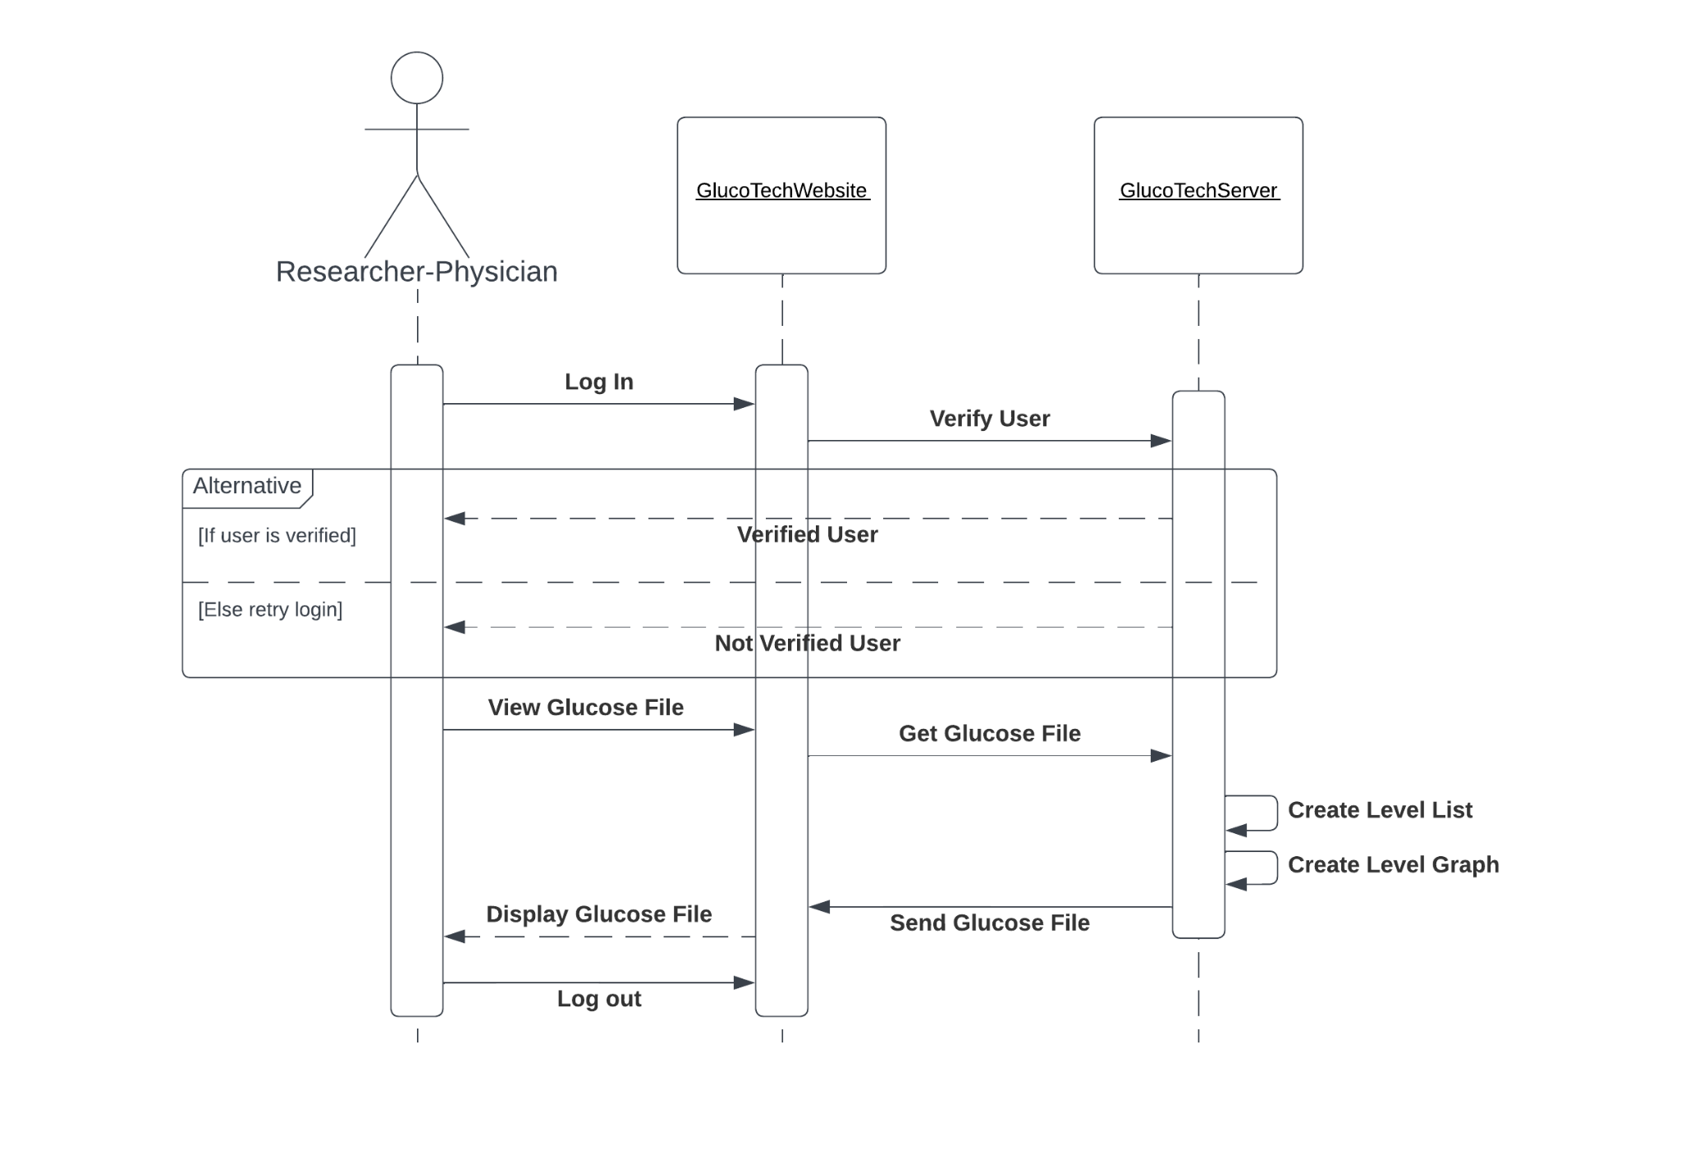
Sequence Diagram #4 (User Story #7)
This sequence diagram shows how a research physician can access the recorded glucose levels of patients from the GlucoTech Website. The research physician must log in through the website using their username and password to gain access to the data. The username and password will be sent to GlucoTech Server for verification. Once the information is verified, the research physician can access the data. The website will display a server-generated blood glucose level list and graph for better data visualization. After obtaining the data, the research physician can log out of their account.

Slide 30
Prototyping

Slide 31
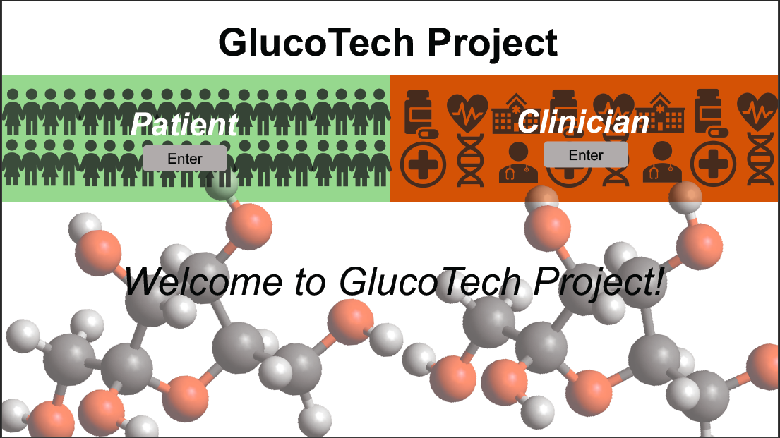

Slide 32
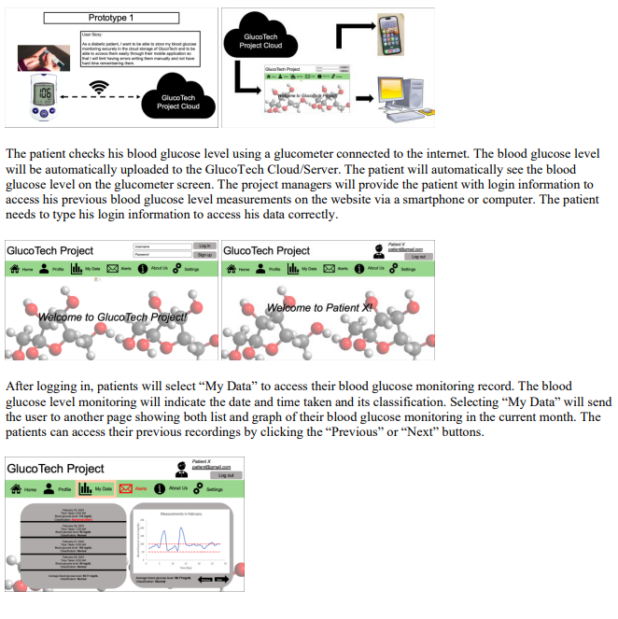
Prototype-1
GlucoTech provides cloud storage and website application for diabetic patients to store their blood glucose monitoring securely.
The patient is provided with login information to access their previous measurements, which can be viewed in graph or list format.
There are four options in the home page, including patient profile, previous measurement, alert system, and help.

Slide 33
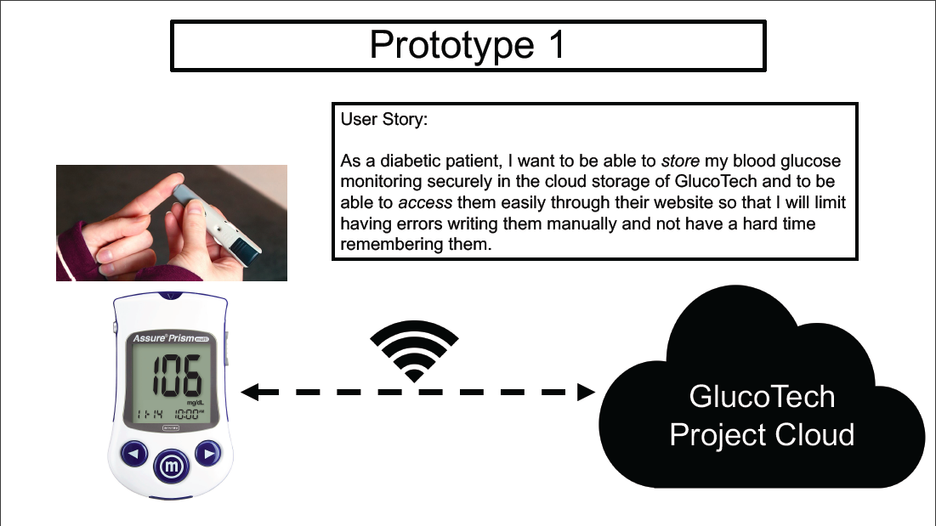

Slide 34
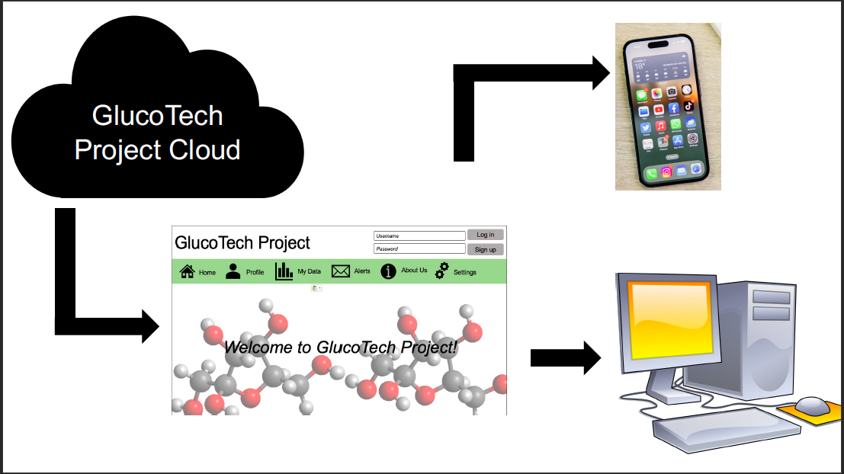

Slide 35
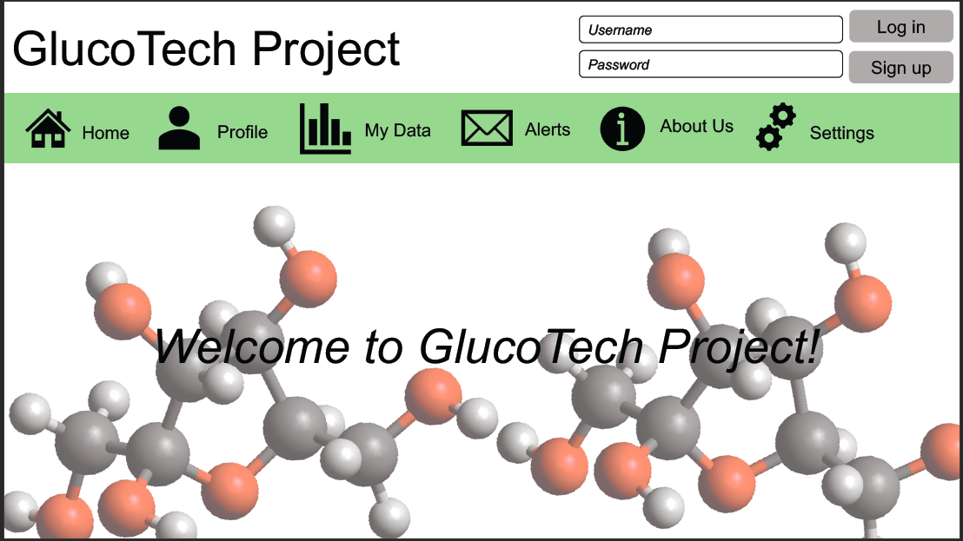

Slide 36
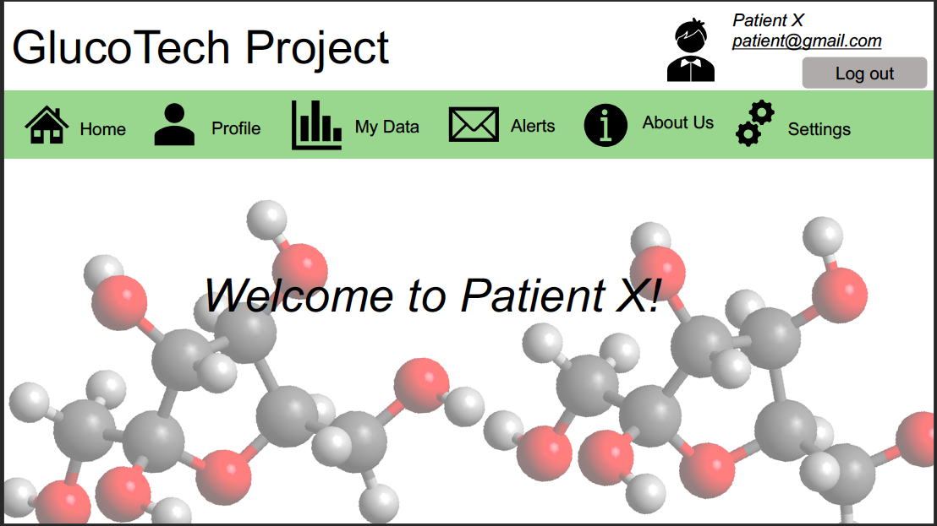

Slide 37
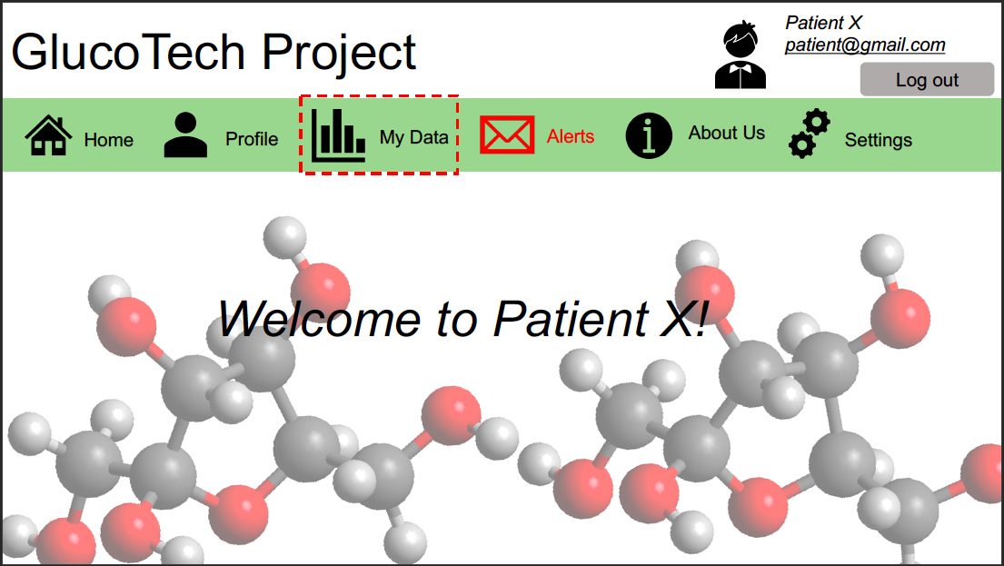

Slide 38
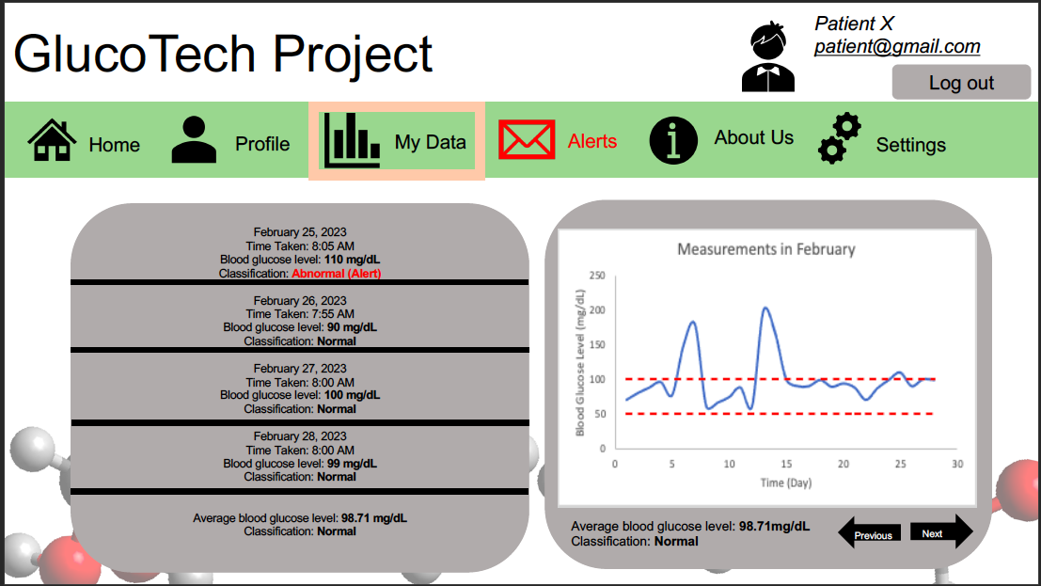

Slide 39
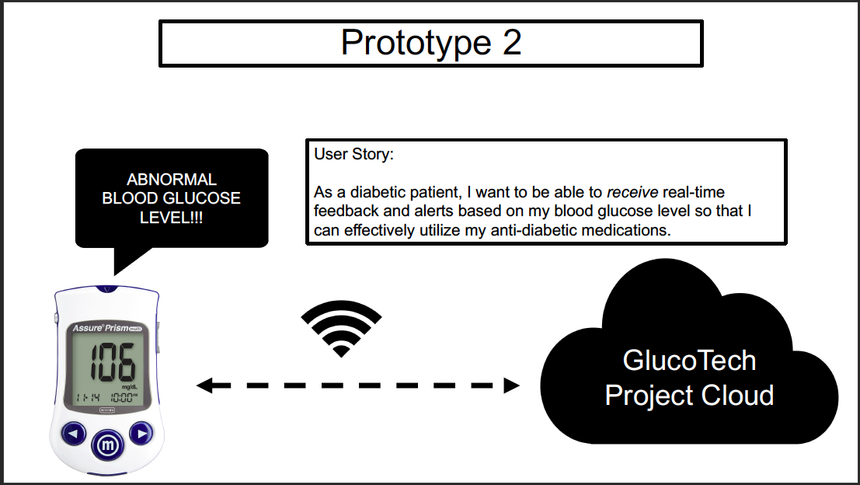

Slide 40
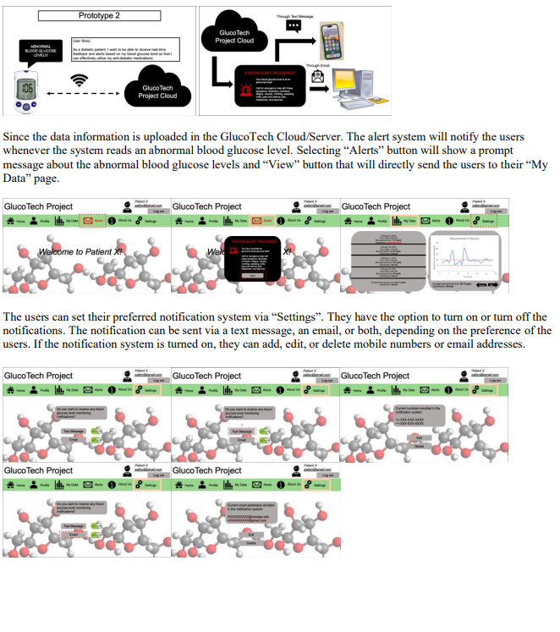
Prototype-2
The GlucoTech Cloud allows diabetic patients to receive real-time feedback and alerts based on their blood glucose level, which can be sent via text message, email, or both.

Slide 41
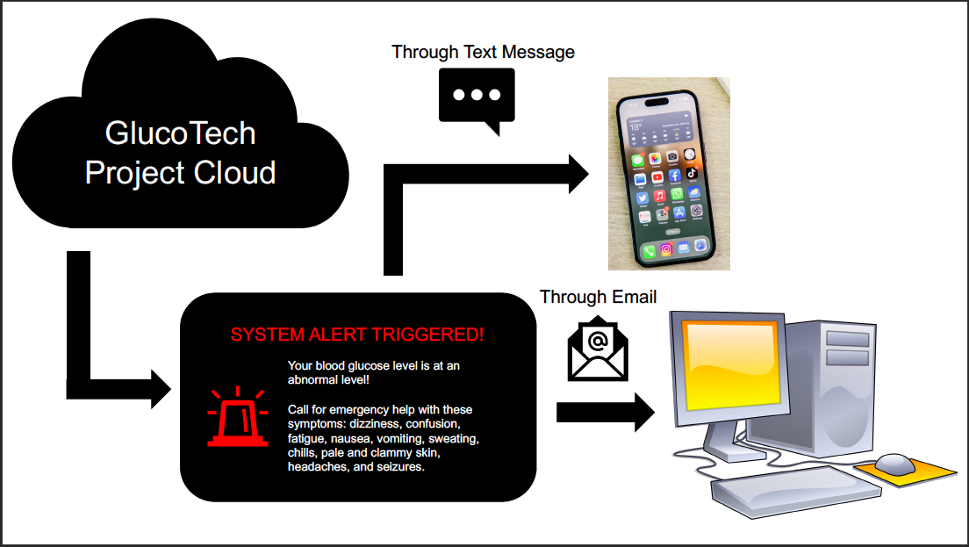

Slide 42
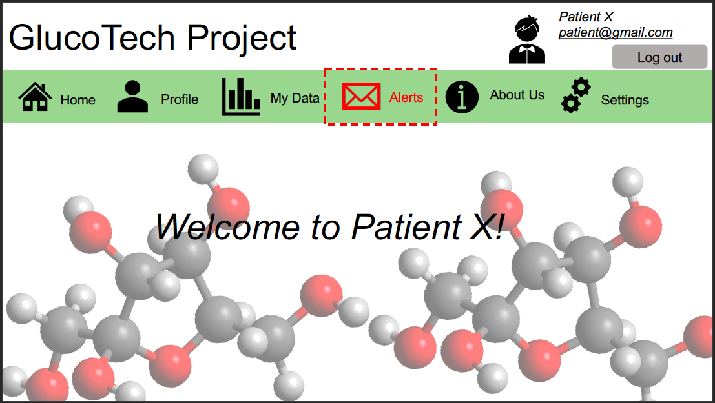

Slide 43
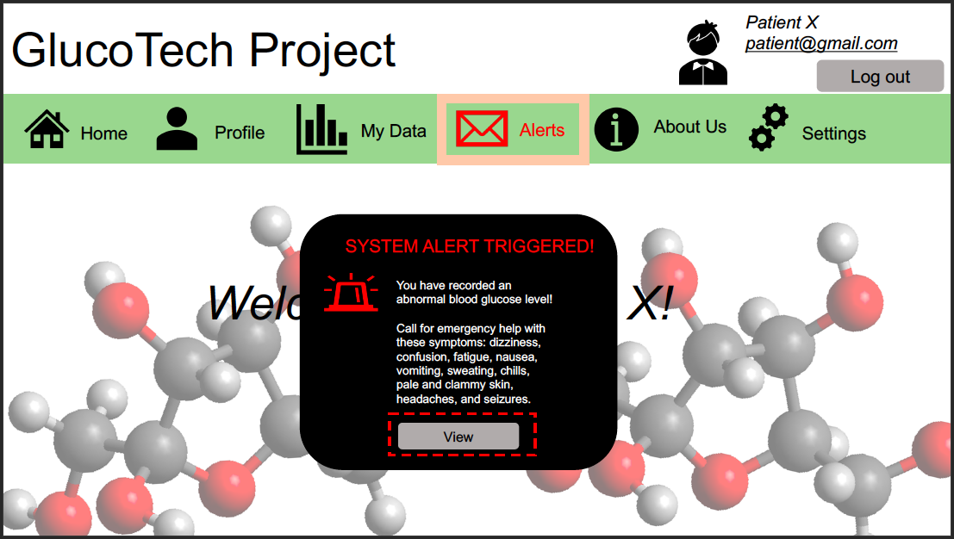

Slide 44
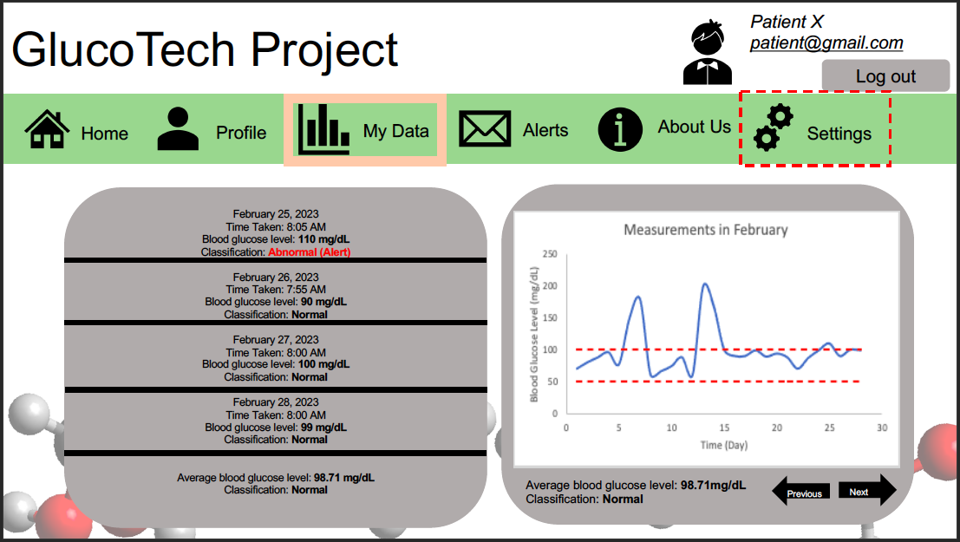

Slide 45
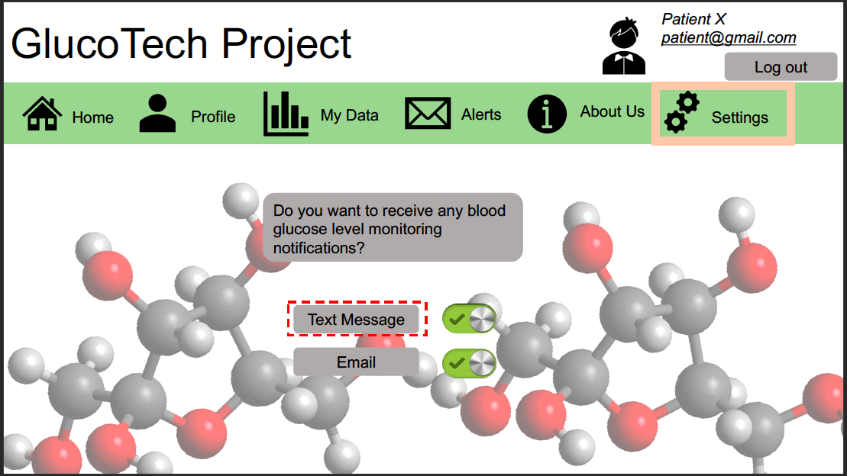

Slide 46
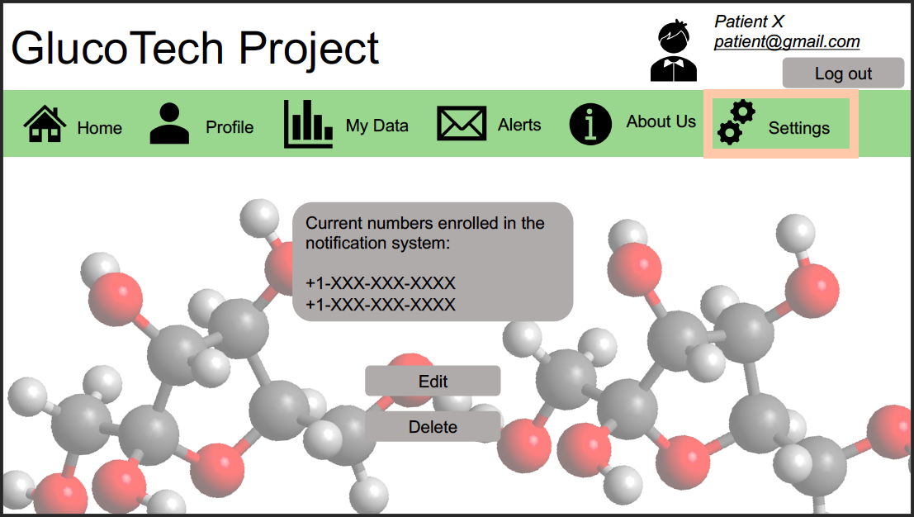

Slide 47
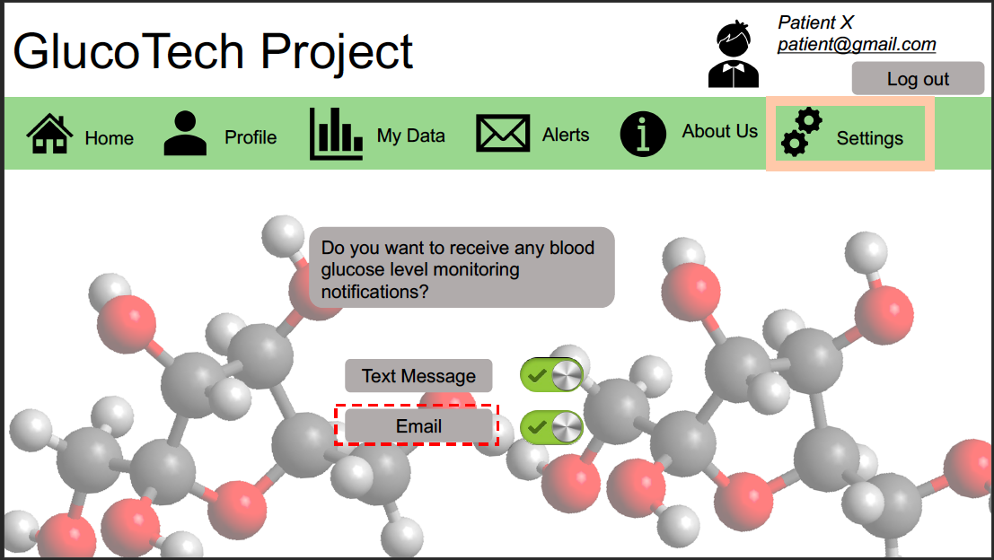

Slide 48
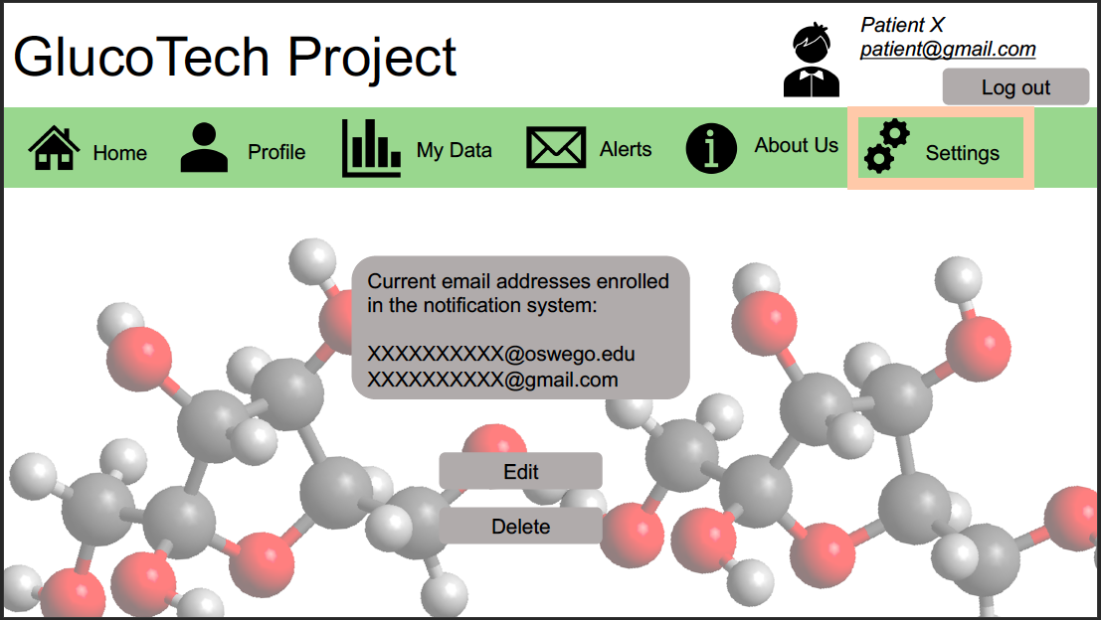

Slide 49
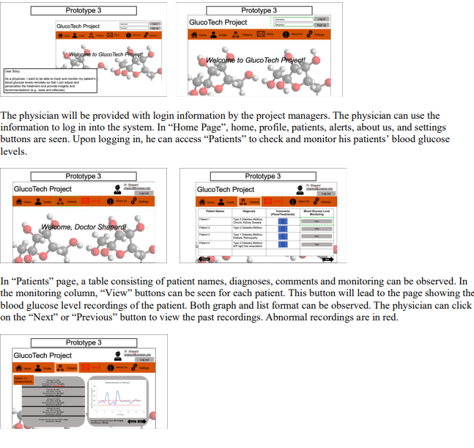
Prototype-3
The physician will be provided with login information to access the system and access "Patients" to check and monitor their patients' blood glucose levels.
The physician can click on the "Next" or "Previous" buttons to view past recordings, with abnormal recordings in red.

Slide 50
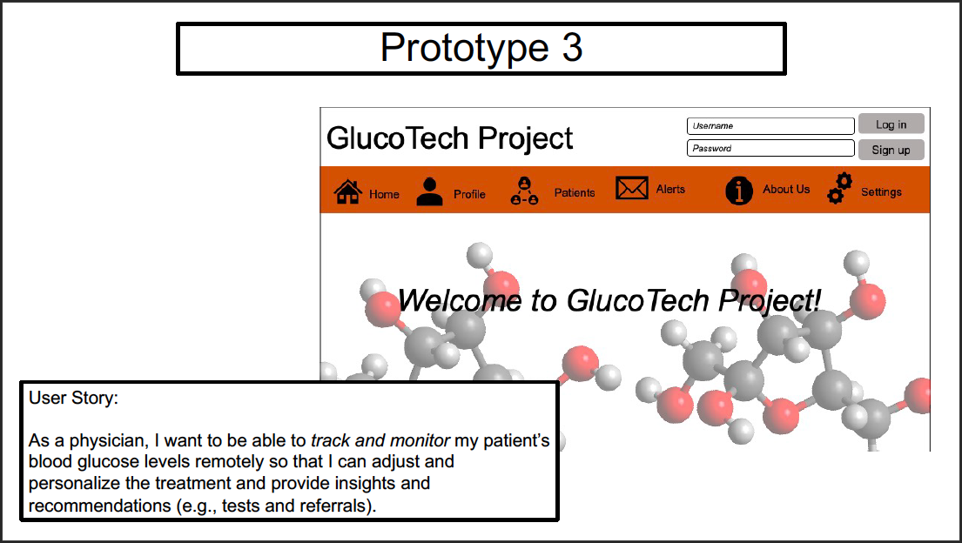

Slide 51
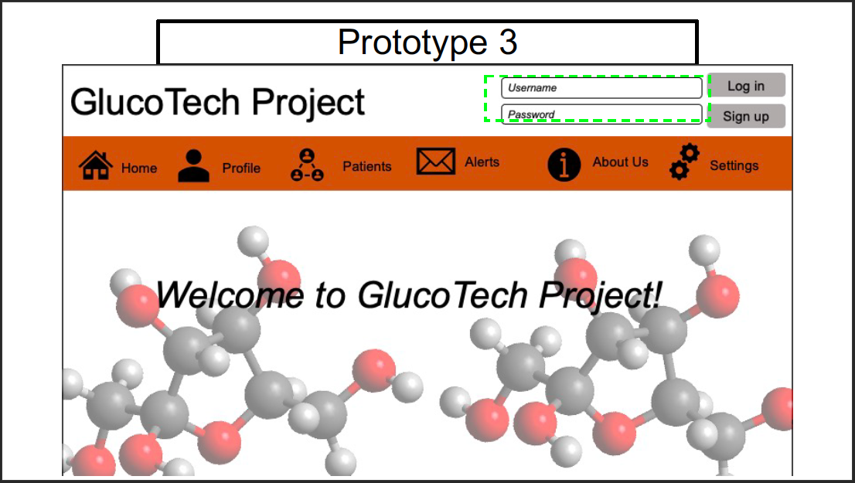

Slide 52
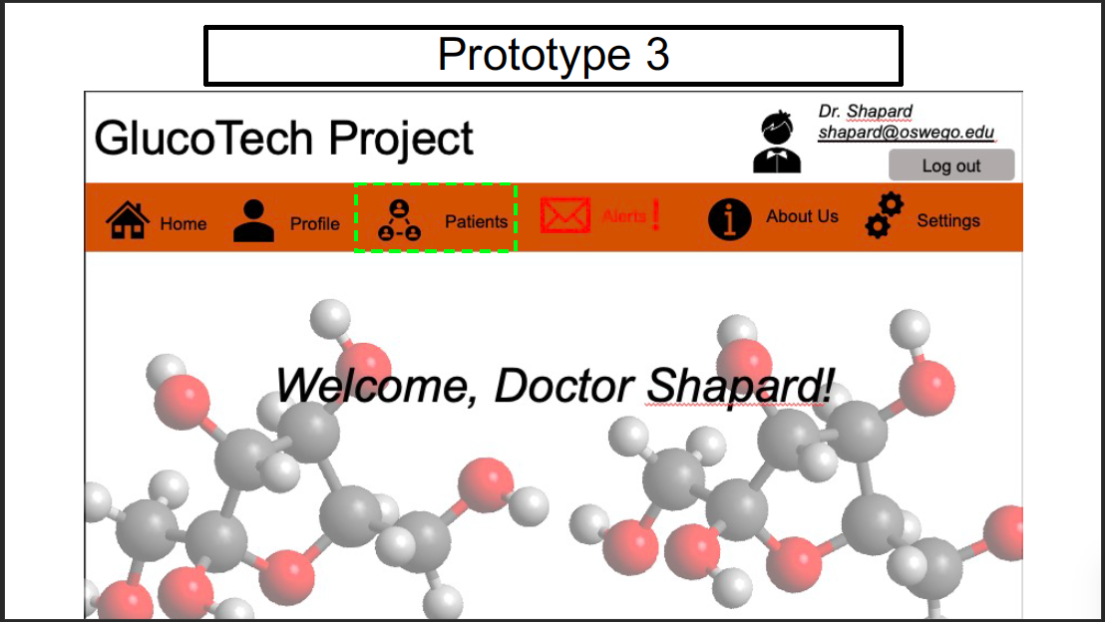

Slide 53
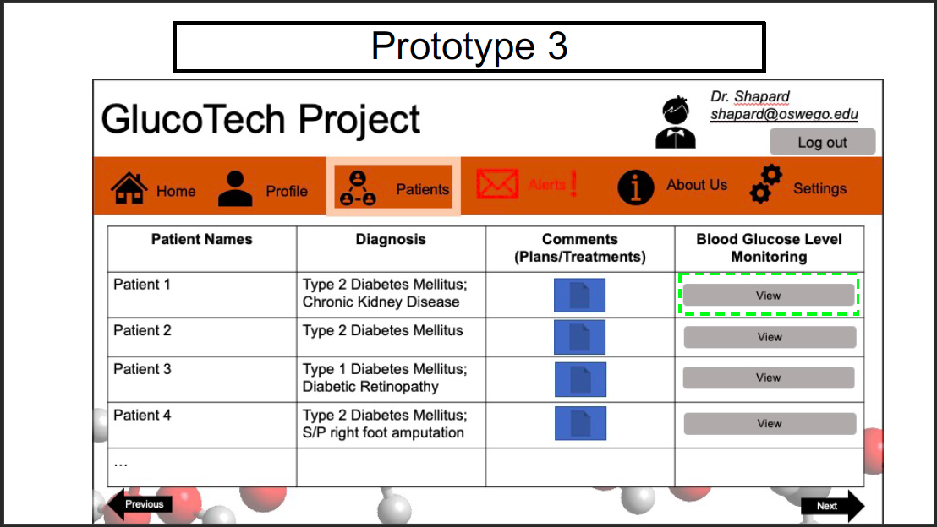

Slide 54
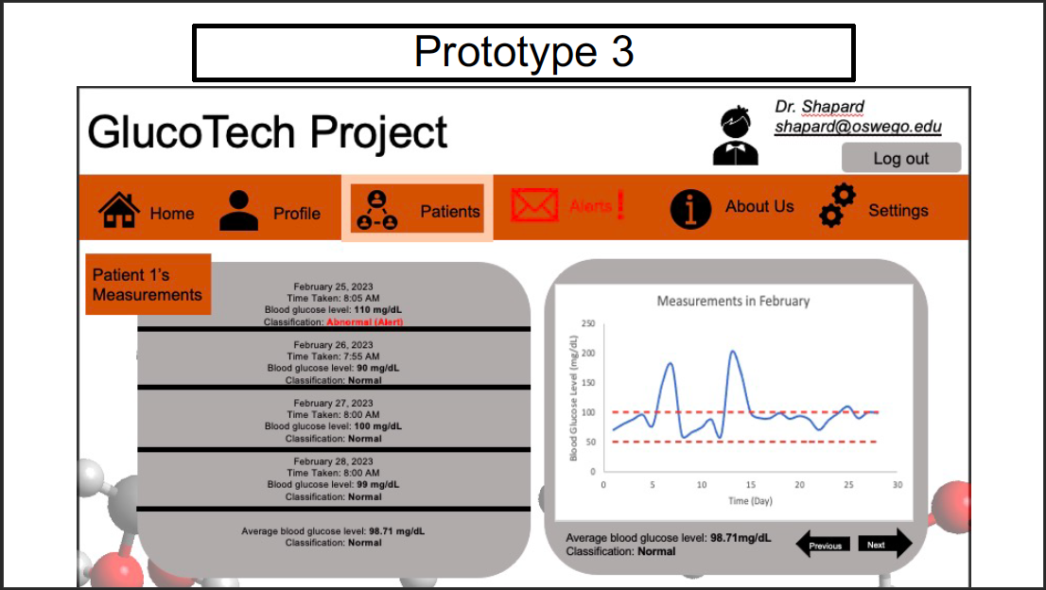

Slide 55
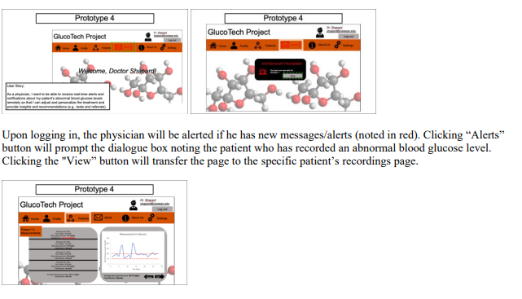
Prototype-4
Physicians can receive real-time alerts and notifications about their patients abnormal blood glucose levels remotely to adjust and personalize treatment.

Slide 56
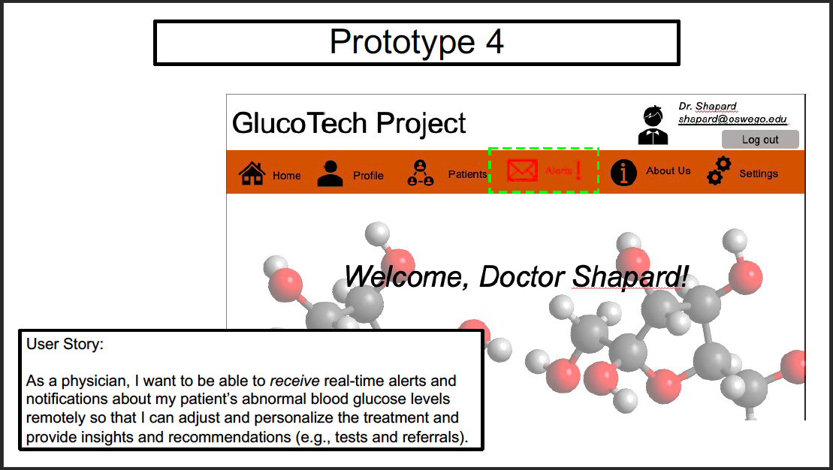

Slide 57
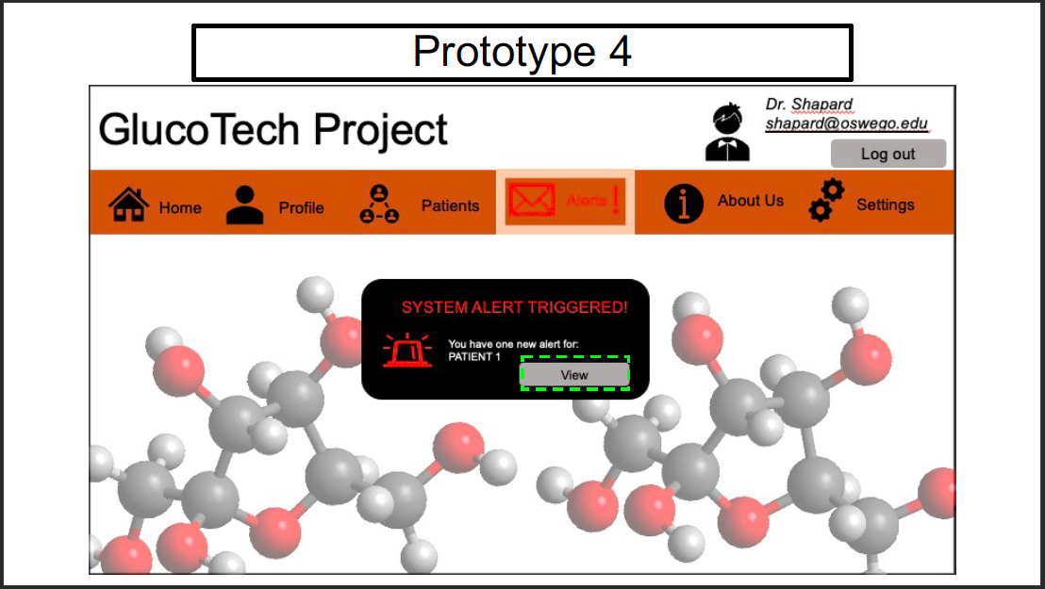

Slide 58
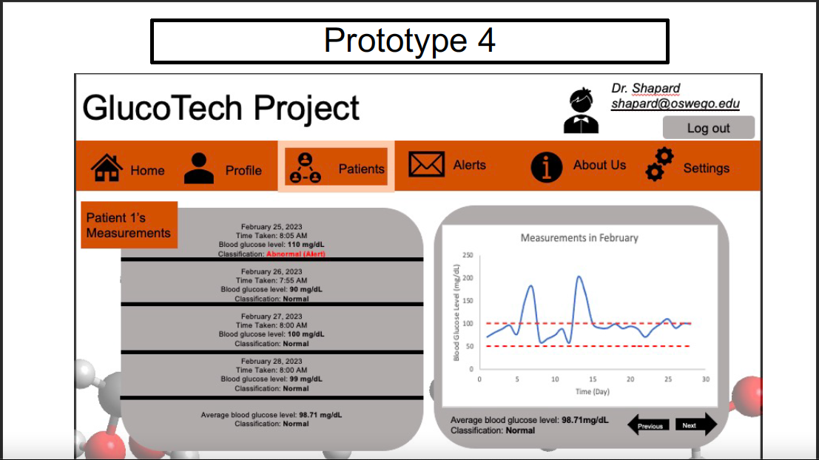

Slide 59
Classes to be coded and tested in this project
User class
GlucoTechServer class
GlucoTechWebsite class
AlertSys class

Slide 60
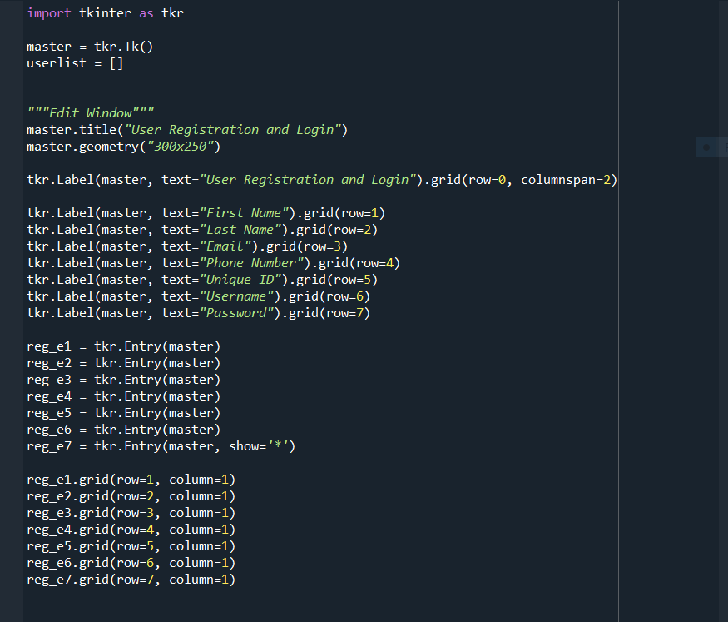
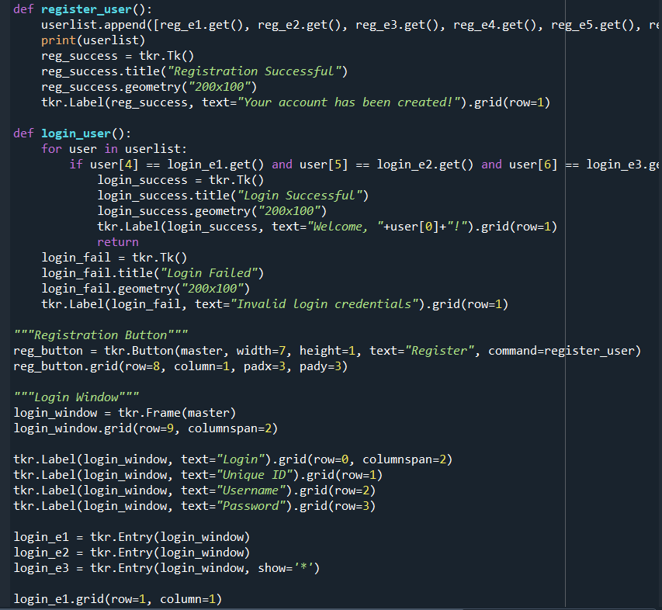
User Class

Slide 61
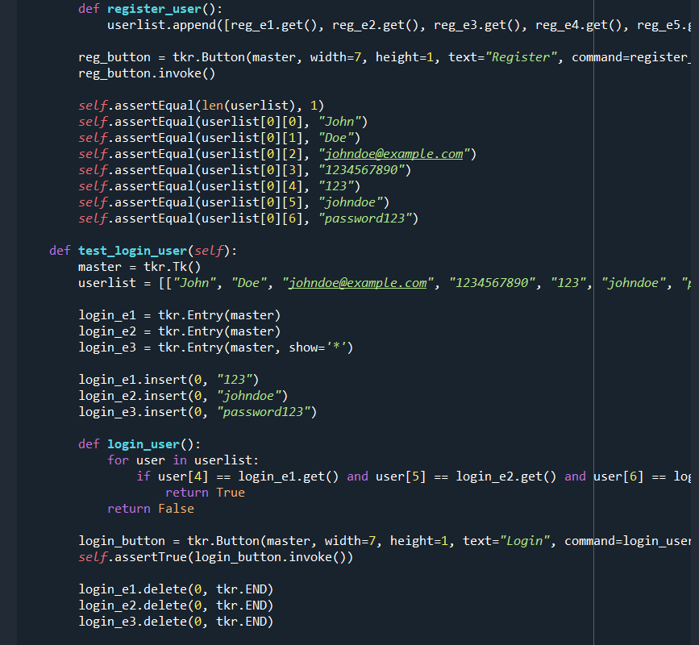
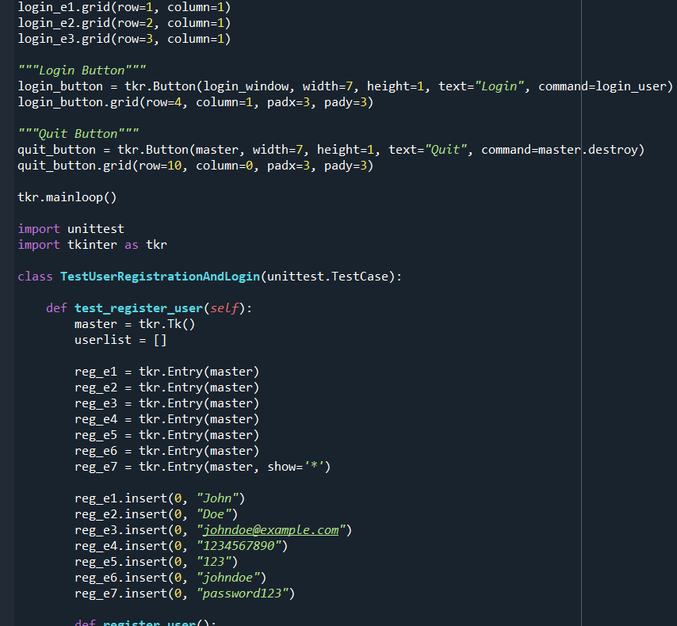
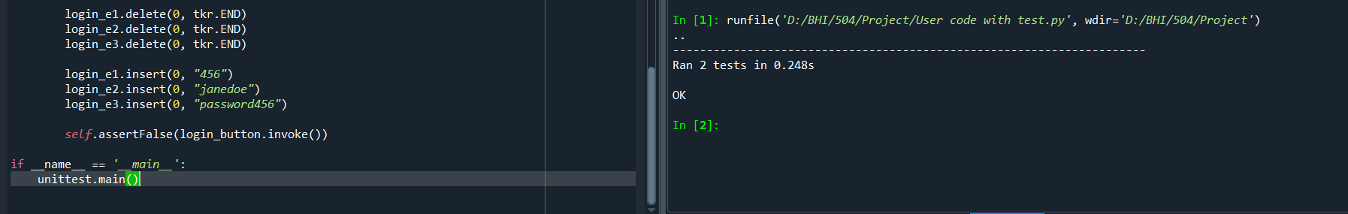

Slide 62

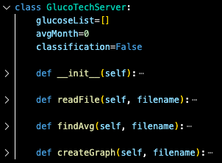
GlucoTechServer Class
Packages
Attributes
Methods

Slide 63



initialization
readFile() method

Slide 64
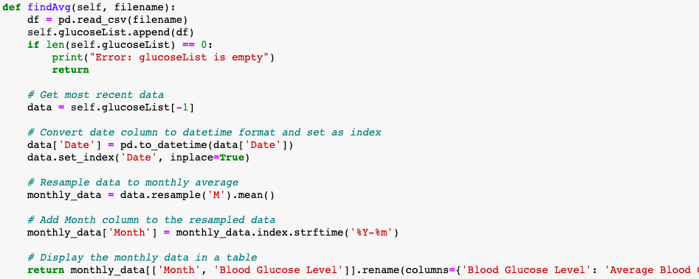
findAvg() method

Slide 65
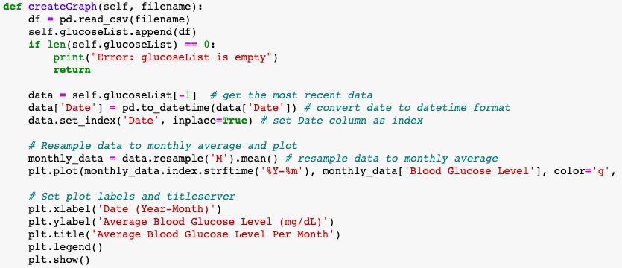
createGraph() method

Slide 66

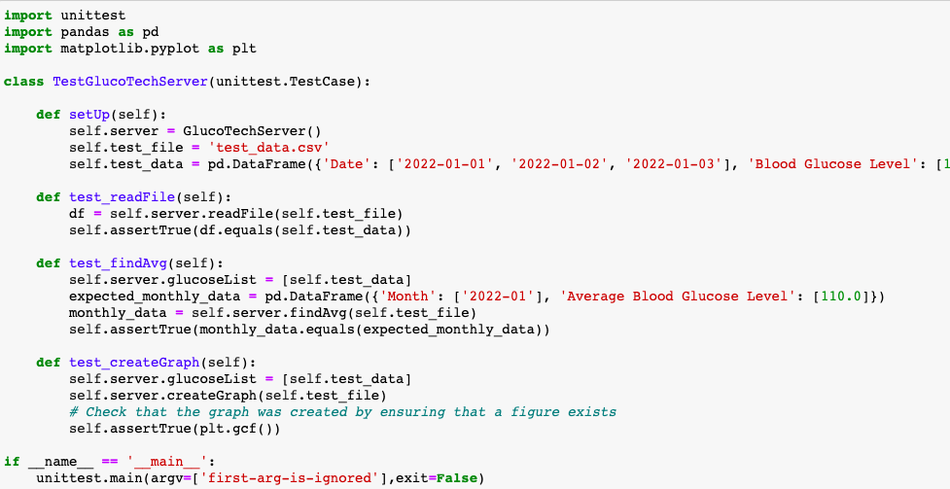
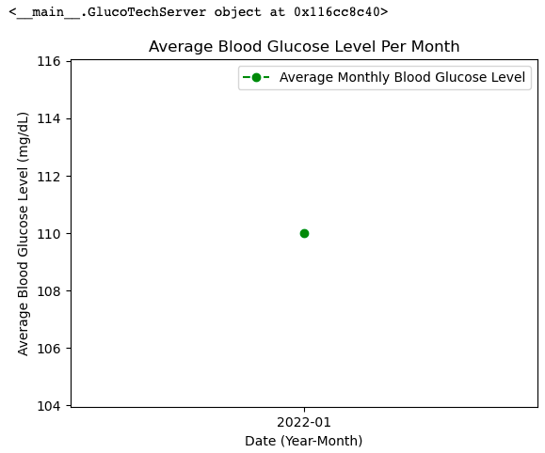
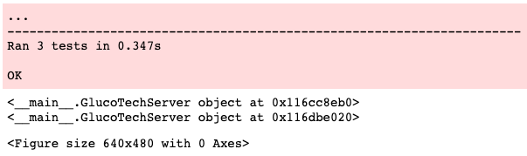
Unit Test for GlucoTechServer Class
test_data.csv
2 attributes
3 instances

Slide 67





Executing GlucoTechServer Class
filename.csv
2 attributes
73 instances

Slide 68


GlucoTechWebsite Class
unittest begins

Slide 69



Slide 70


AlertSys
Executing AlertSys Class

Slide 71


Unit Testing

Slide 72



AlertSys Class coding

Slide 73
Future Work
and
Final Thoughts

Slide 74
Future Work and Final Thoughts
Future works for the GlucoTech Project add additional features such as a nutrition tracker, exercise tracker, and medication reminders.
It could also potentially incorporate data from wearable devices.
Overall, the GlucoTech Project has the potential to significantly improve the management of diabetes mellitus and reduce the risk of complications.
With the help of biomedical and health informatics, this project can continue to evolve and provide more personalized and effective care for individuals with diabetes.

Slide 75
References
Centers for Disease Control and Prevention(2023, February 28). Diabetes Tests. Retrieved April 29, 2023, from, https://www.cdc.gov/diabetes/basics/getting-tested.html#:~:text=Glucose%20Screening%20Test&text=You'll%20drink%20a%20liquid,take%20a%20glucose%20tolerance%20test.
ElSayed, N. A., Aleppo, G., Aroda, V. R., Bannuru, R. R., Brown, F. M., Bruemmer, D., ... & Gabbay, R. A. (2023). 1. Improving Care and Promoting Health in Populations: Standards of Care in Diabetes—2023. Diabetes Care, 46(Supplement_1), S10-S18.
National Diabetes Data Group (US), National Institute of Diabetes, Digestive, & Kidney Diseases (US) (1995).Diabetes in America(No. 95). National Institutes of Health, National Institute of Diabetes and Digestive and Kidney Diseases.
World Health Organization (2019). Classification of Diabetes. Geneva.
Mayo Clinic. (2023, January 20). Diabetes. Mayo Clinic. Retrieved February 19, 2023, from https://www.mayoclinic.org/diseases-conditions/diabetes/diagnosis-treatment/drc-20371451

