Slide 1
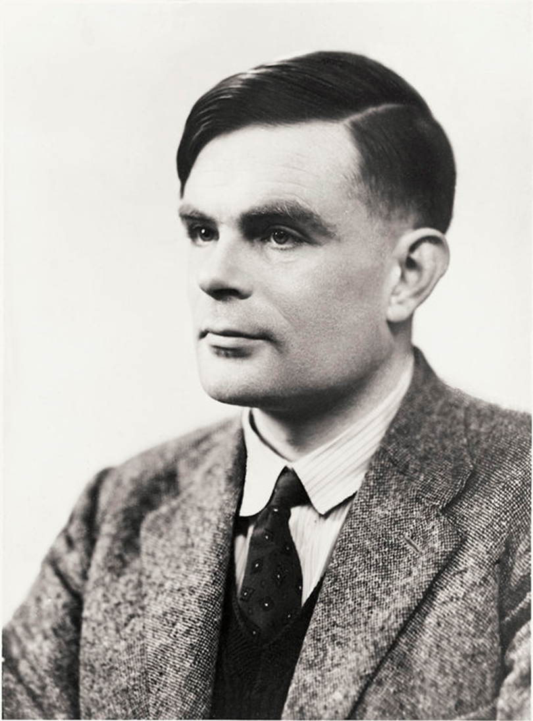
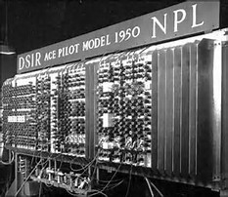
Alan Turing
By: Will Schell
1912-1954

Slide 3
The Turing Test
Question: Can Machines Think?
Imitation Game
Relation to mind

Slide 4
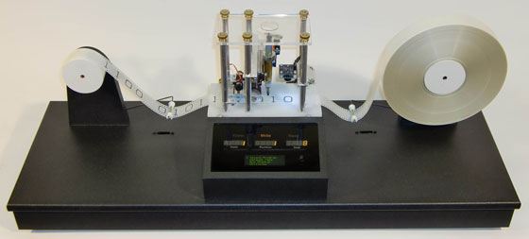
The Turing Machine
What it is/does
Original Purpose
Why is this important?
ACE

Slide 5
Picture References
http://paidpost.nytimes.com/the-weinstein-company/world-war-iis-greatest-hero-the-true-story-of-alan-turing.html#.WKxMfn_ENPY
http://www.alanturing.net/turing_archive/archive/infopages/london1st.html
http://www.thehistoryblog.com/archives/21186
http://mlmtheamericandreammadenightmare.blogspot.com.es/2013_12_01_archive.html
https://www.bing.com/images/search?view=detailV2&ccid=l9Ecdsii&id=842E2F540B3E8889762580598074086DBFAA40B4&q=Original+Turing+Machine&simid=607989756402076177&selectedIndex=7&ajaxhist=0

